Slide 1

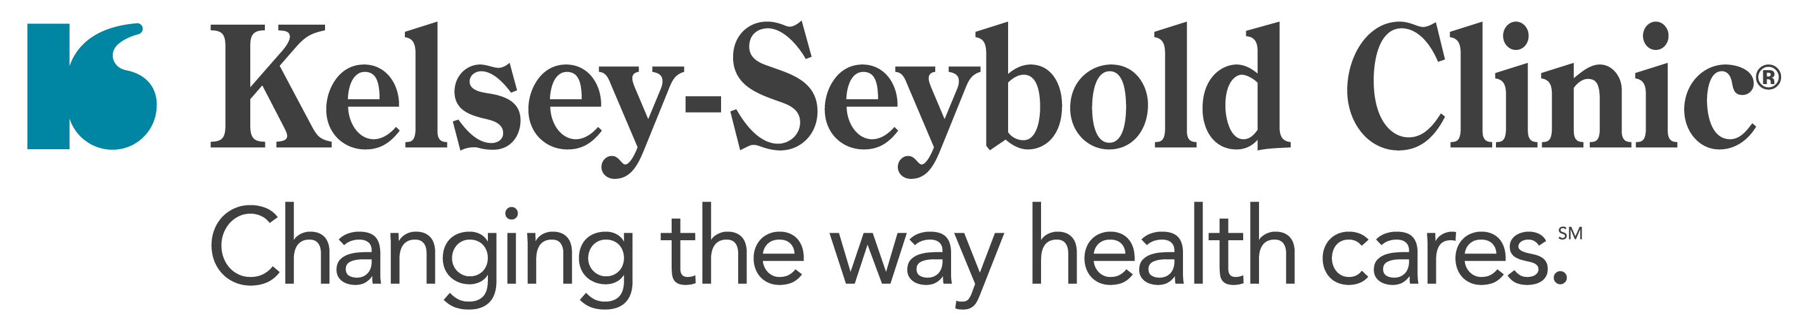
Kelsey-Seybold
Healthy Living
Workshop
Medical Intervention & Surgical Treatment
PRESENTED BY
Shravan Sarvepalli, MD

Slide 2
Definition of Obesity
Body Mass Index
Normal Weight
Overweight
25-29.9
Obesity
30-34.9
≥40
Severe Obesity
Morbid Obesity
35-39.9
<25
https://asmbs.org/patients/bmi-calculator/

Slide 3
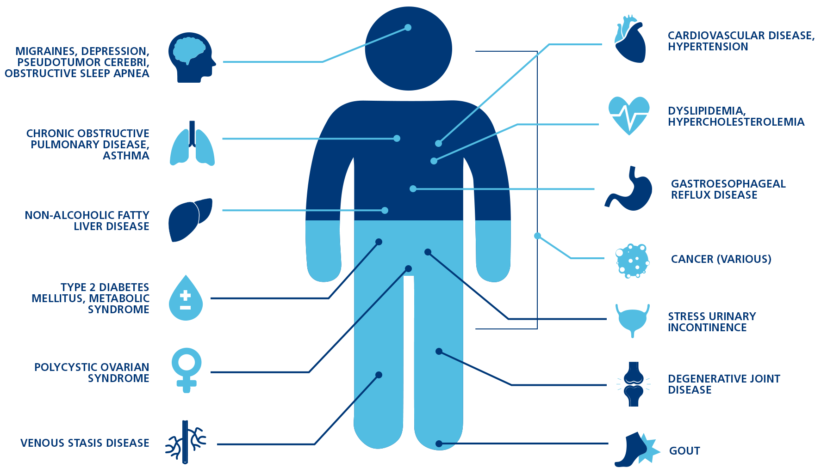
Complications of Obesity

Slide 4


Goal = Weight Loss
Treat​ diseases caused by obesity​
Prevent diseases caused by obesity
Improved cosmetic or physical appearance

Slide 5

Treatment Options
Lifestyle Modifications
Anti-Obesity Medications
Endoscopic Procedures
Metabolic Surgery

Slide 6


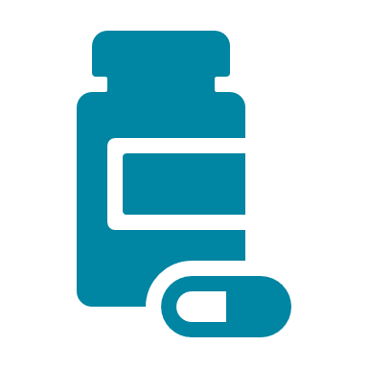

Combination Therapy
Patients that combine multiple modalities of weight loss are more successful than those that focus on a single form of weight loss
Diet and exercise are the corner stone of medically supervised weight loss
Patients with BMI >27 may benefit from the addition of medication to facilitate weight loss
Patients with BMI >35 may benefit from the addition of surgical treatments to facilitate weight loss

Slide 7

Diet
Increase intake of fruits, vegetables, and whole grains
Choose fish and poultry over red meats
Meal prep
Avoid
Processed Food
Take-out, Fast-food
Fad Diets

Slide 8

Physical
Activity
150 minutes of moderate to high intensity activity per week
Two days of muscle strengthening activity per week

Slide 9

Behavioral Therapy
Strong link exists between mood and eating behavior
Both positive and negative emotions can impact diet
Unlinking mood and diet can result in significant weight loss

Slide 10
Medications
Great tool to help patients lose weight, when combined with exercise and dietary changes.
Typically results in 5-15% total body weight loss (TBWL). Newer medications (GLP-1 agonists) are associated with 10-20% TBWL.
Results in significant improvement of metabolic syndrome
Patients may experience side effects
Patient regain weight after stopping medications

Slide 11

Medications
GLP-1 Agonists
Appetite suppressants
Antidepressants

Slide 12

GLP-1 Agonists
Patients with obesity:
Indication: BMI>30, or BMI >27 with co-morbidity, patients older than 12.
Dosing: start with 0.25 mg, increase by 0.5 mg every 4 weeks, until week 12 (max 2 mg/week).
Mean weight loss: 15% TBWL
  >10% TBWL: 69% of patients
  >15% TBWL: 51% of patients
  >20% TBWL: 32% of patients
Not covered by most health plans
Patients with Type II Diabetes (HgA1c>6.4)

Slide 13
Appetite Suppressants
Indication: BMI >27 or BMI>30 with comorbidity
For short-term use
Expected weight loss: 5-10% TBWL
Side effects: tremors, palpitations, anxiety, nausea, vomiting

Slide 14
Anti-depressants
Indication: BMI >30 or BMI >27 with one co-morbidity
Expected weight loss: 5-10% TBWL
Side effects: nausea, constipation, headaches, insomnia, dry mouth

Slide 15

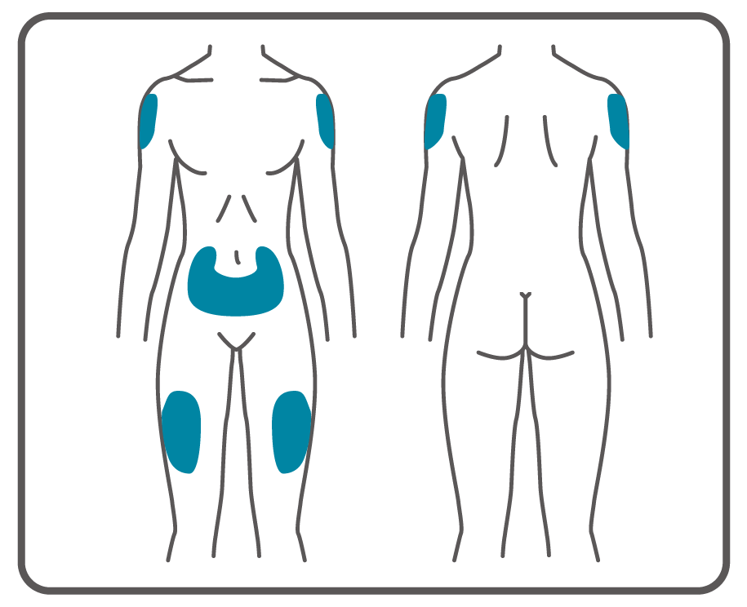
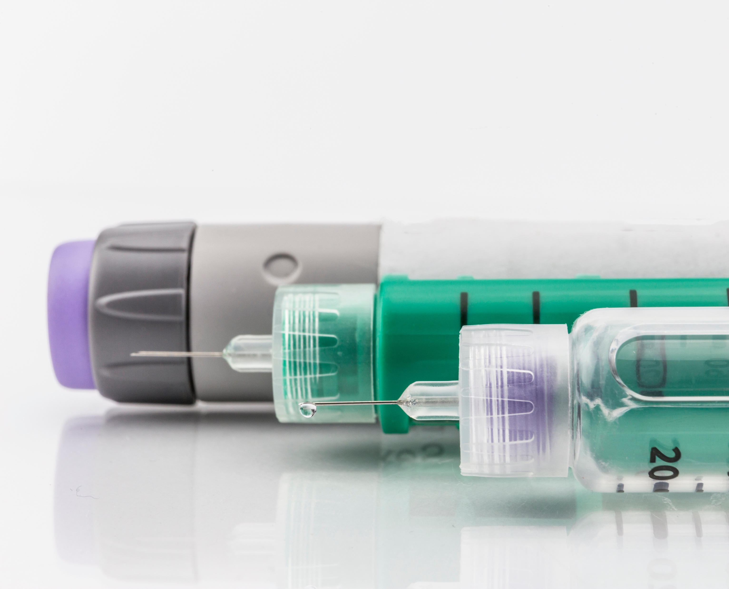
Injectable Medication

Slide 16
Side Effects
Gastroparesis (delayed gastric emptying)
  nausea, vomiting
Indigestion, diarrhea, constipation
Absorption of contraceptives are reduced by 40%
Vitamin deficiencies (thiamine, iron, B12)
Rare side effects: pancreatitis, thyroid C-cell tumors, cholelithiasis, suicidal ideation

Slide 17
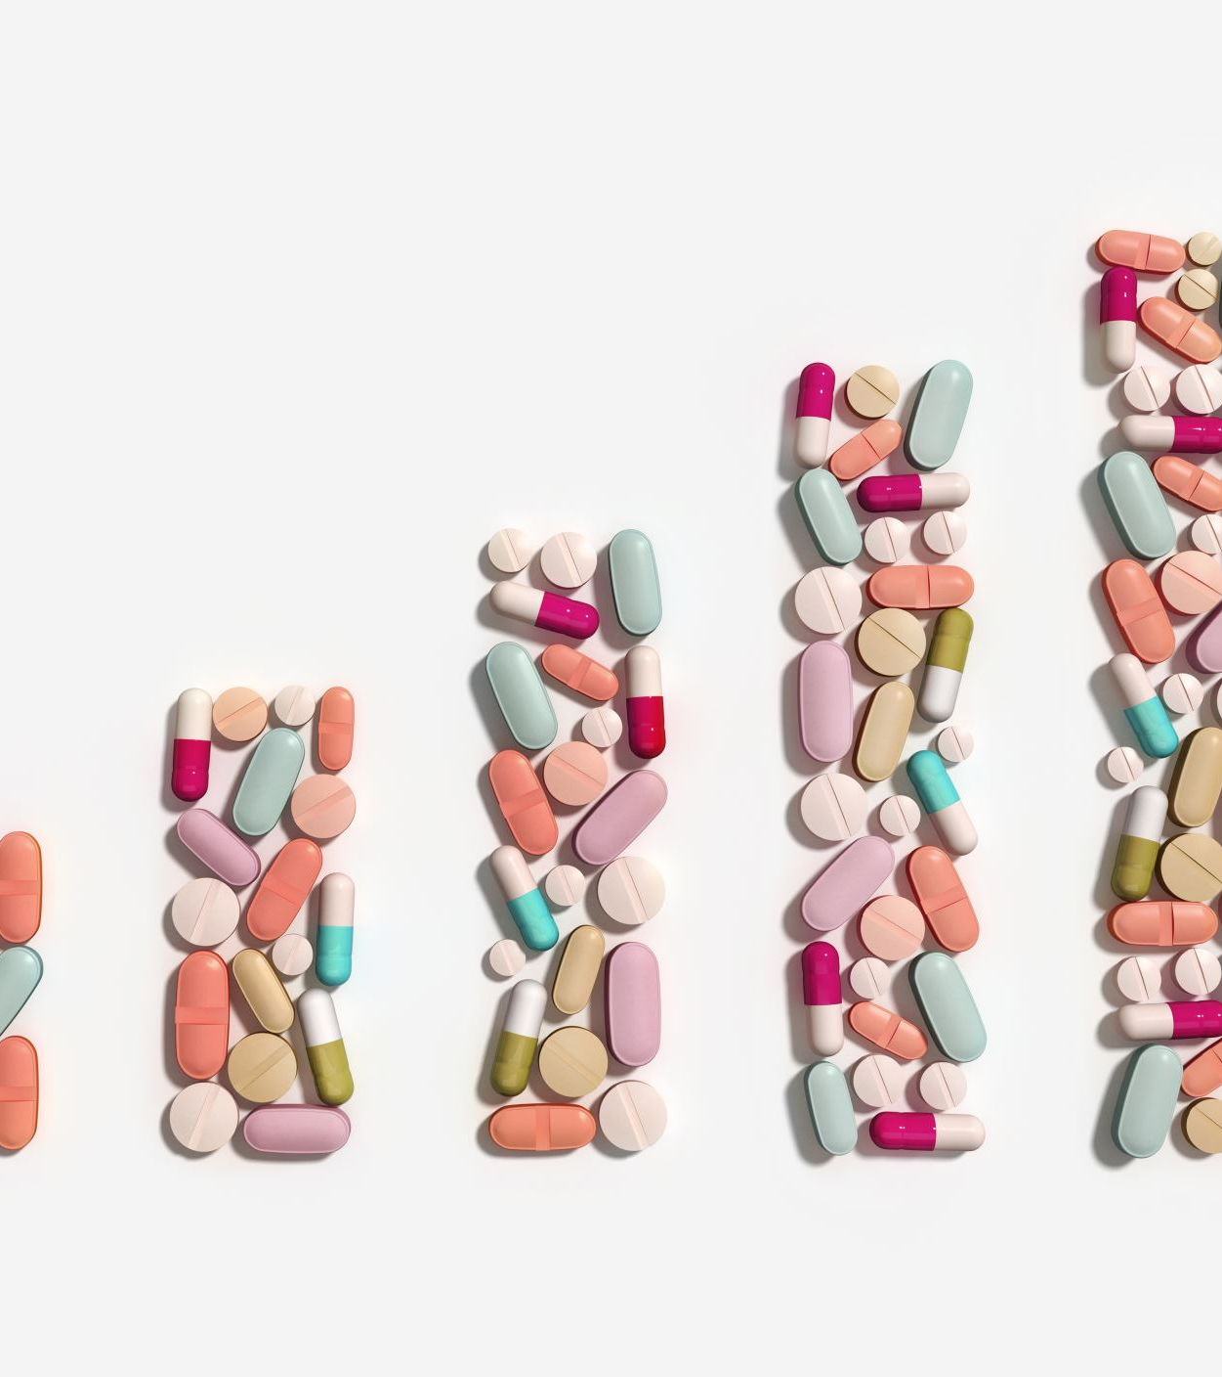
Who can prescribe anti-obesity medications?
Primary Care Physicians
Obesity Medicine Providers
Endocrinologists
Bariatric Surgeons

Slide 18
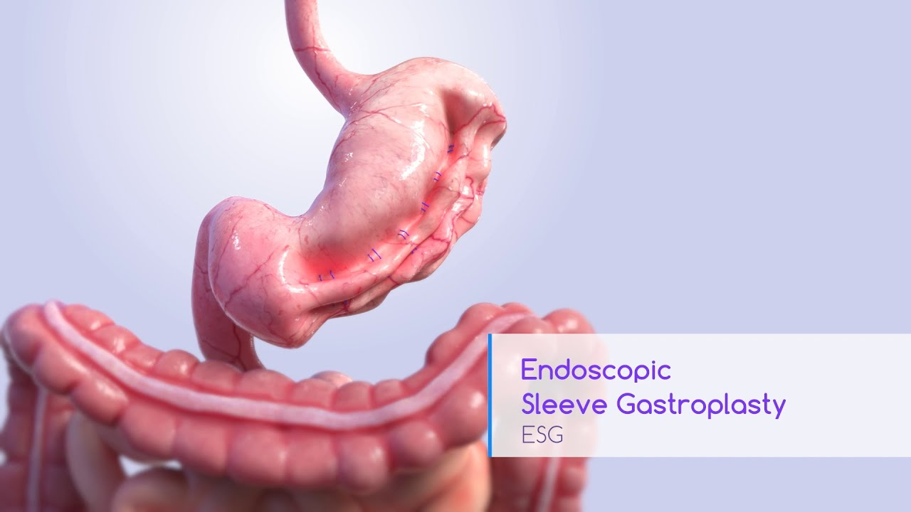
Endoscopic
Sleeve
15-20% TBWL, when combined with lifestyle changes.
1-2 hour procedure. Patients go home the same day. ​
No incisions, reversible.

Slide 19

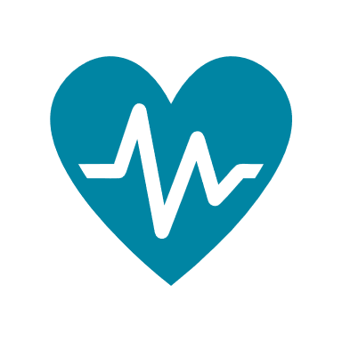

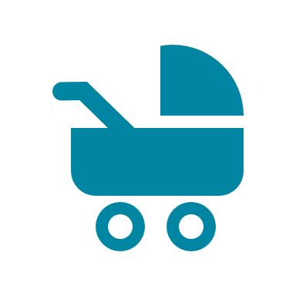


Benefits associated with modest weight loss
Improved glucose metabolism
Reduction in blood pressure
Reduction in cholesterol levels
Improvements in infertility or Polycystic Ovarian Syndrome
Improved quality
of life
Improved mobility

Slide 20
Metabolic / Bariatric Surgery
20-40% TBWL
Safer than most commonly-performed procedures such as gallbladder surgery, or knee replacement
1-3 hour procedure, 1 night in the hospital, 2 weeks recovery after surgery
Durable, results in long-term weight loss
Best treatment available to treat or prevent diabetes

Slide 21
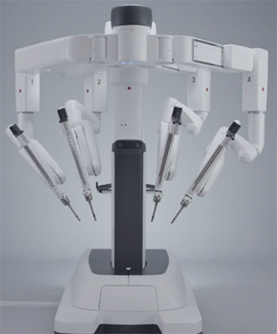
Robotic Bariatric
Surgery
Sleeve Gastrectomy
Gastric Bypass

Slide 22
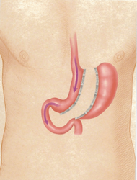
Benefits
Total body weight loss: 25-30%
Co-morbidity resolution (diabetes, high blood pressure and cholesterol, sleep apnea, arthritis etc.)
Mechanism: restrictive, metabolic
Sleeve Gastrectomy Surgery
MBSAQIP
Risk/Benefit Calculator

Slide 23
Risks
Short term
  Leak, bleeding, infection, injury to nearby structures, blood clots, heart attack, stroke, death
Long term
  Weight regain, Internal hernia, marginal ulceration, dumping syndrome, fullness and nausea, acid reflux
Sleeve Gastrectomy Surgery

Slide 24
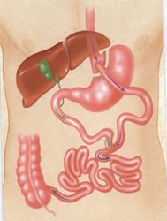
Benefits
Durable treatment for obesity
30-40% TBWL
Higher rate of diabetes, sleep apnea, acid reflux, arthritis resolution compared to non-surgical obesity treatments
Decreases risk of developing cancer
Mechanisms: restriction, malabsorption, metabolic
Gastric Bypass Surgery

Slide 25
Risks
Short term
  Leak, bleeding, infection, injury to nearby structures, blood clots, heart attack, stroke, death
Long term
  Weight regain, vitamin deficiencies, dumping syndrome, fullness and nausea, hernias, marginal ulceration
Gastric Bypass Surgery

Slide 26

Telehealth
Surgical consultations and all follow up appointments can be scheduled as virtual visits for your convenience.
In person visits are required in certain situations.

Slide 27

Combination Therapy
Treatment | Overweight (BMI 25-26.9) | Overweight (BMI 27-29.9) | Obesity (BMI 30-34.9) | Severe Obesity (BMI 35-39.9) | Morbid Obesity (BMI ≥ 40)
Diet Physical activity Behavioral Therapy
Medication
Endoscopic treatment
Surgery for weight loss

Slide 28
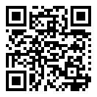
Resources
www.kelsey-seybold.com/weightlosssurgery
www.asmbs.org/for-patients
www.rethinkobesity.com
www.diabetes.org

Slide 29

Start Your Weight Loss Journey Today!

