Slide 1
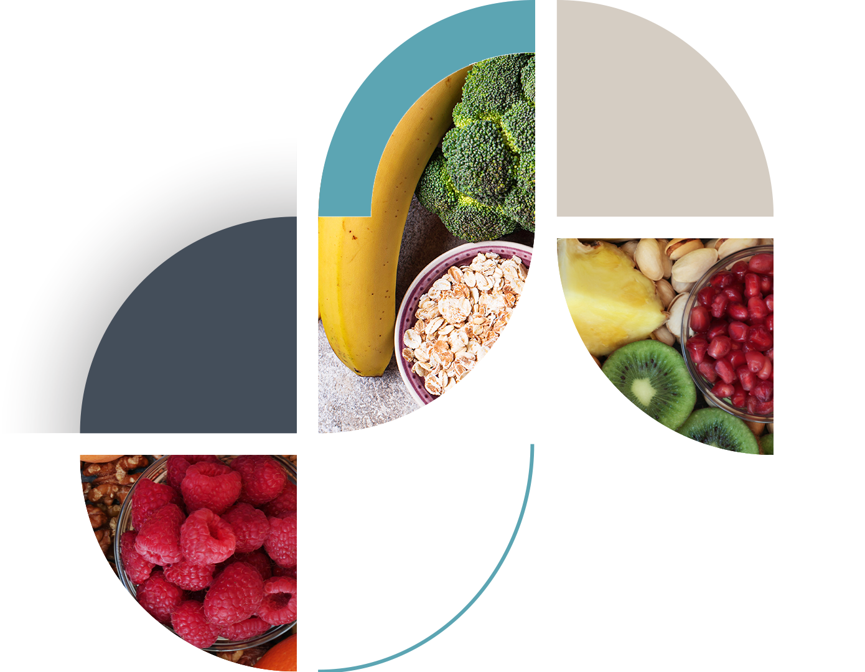
Kelsey-Seybold Healthy Living Workshop for Adolescents
Creating Healthy Habits for a Lifetime
Notes:
Welcome to the Kelsey-Seybold Healthy Living Workshop. We will be sharing with you some ways to create healthy habits for the entire family.

Slide 2
Objectives
Define 5-2-1-0 Healthy Lifestyles
Ways to be healthy together
Meal planning to increase whole fruits and vegetables
Understanding portion sizes
Brainstorm ideas to limit screen time.
Rethink your drink - discuss how beverages effect weight
Explore ways to incorporate physical activity/exercise into daily routine
Goal setting to stay motivated and make positive changes

Slide 3
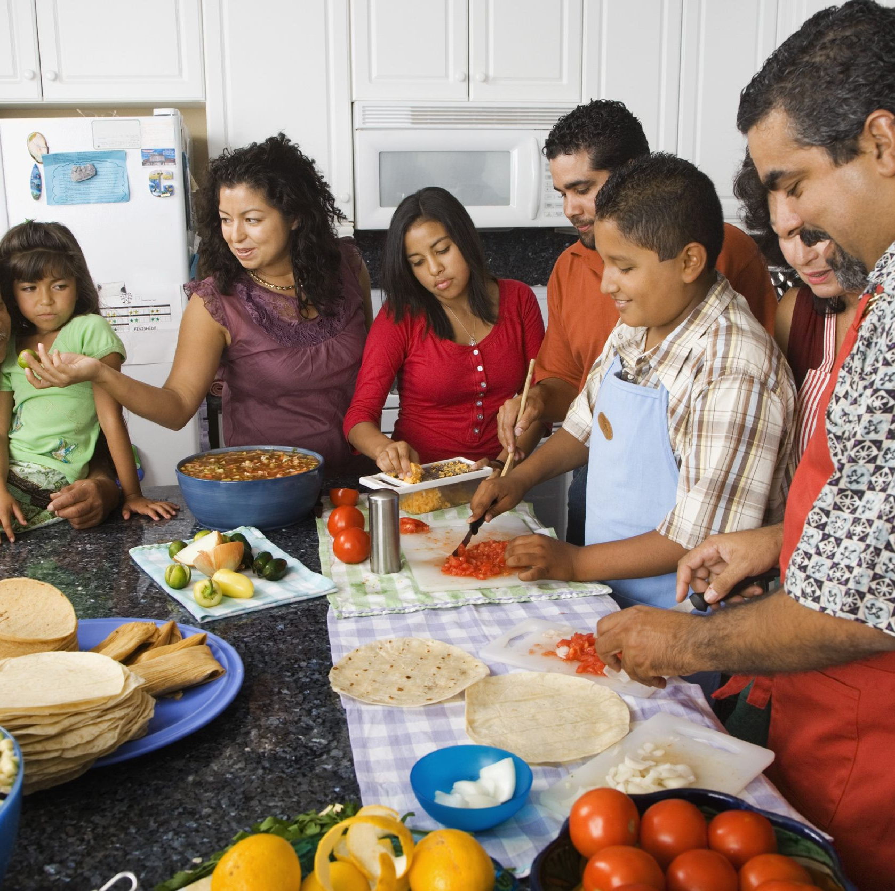
Make healthy choices together
Plan meals for the week as a family
Work together as a family in preparing meals
Eat meals together as a family when possible
Can you think of ways to create a positive experience at mealtime?
Notes:
Sometimes we’re tempted to reward good behavior with food. While your kids may enjoy this, invite them to suggest alternative rewards that are not food based. As you come up with ideas, create a list of inexpensive rewards and post it where the whole family can see it. You can also put together a separate list of special rewards to recognize fabulous achievements.

Slide 4
You can take an active role in promoting a healthy lifestyle.
Notes:
So how can we reverse this insulin resistance? By doing 5 2 1 0 everyday.

Slide 5
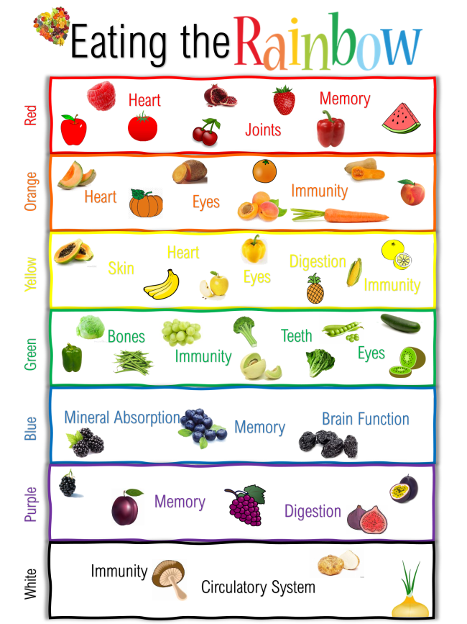
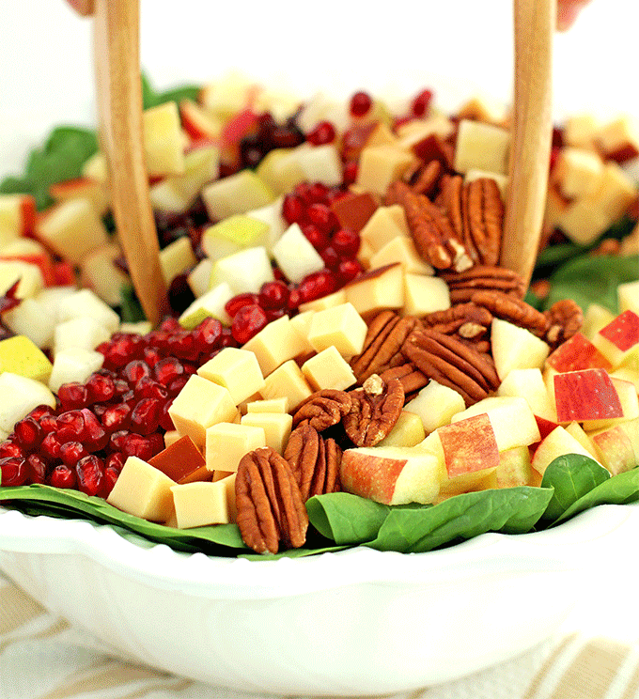
Eat five or more servings of vegetables and fruit everyday. They're loaded with nutrients that boost energy, fuel brain cells, and fight illness.
Source: smallhandsbigdreams
Notes:
What colors do you see? How many colors can you get on your plate? The more colorful your plate is, the more plant nutrients there are.

Slide 6
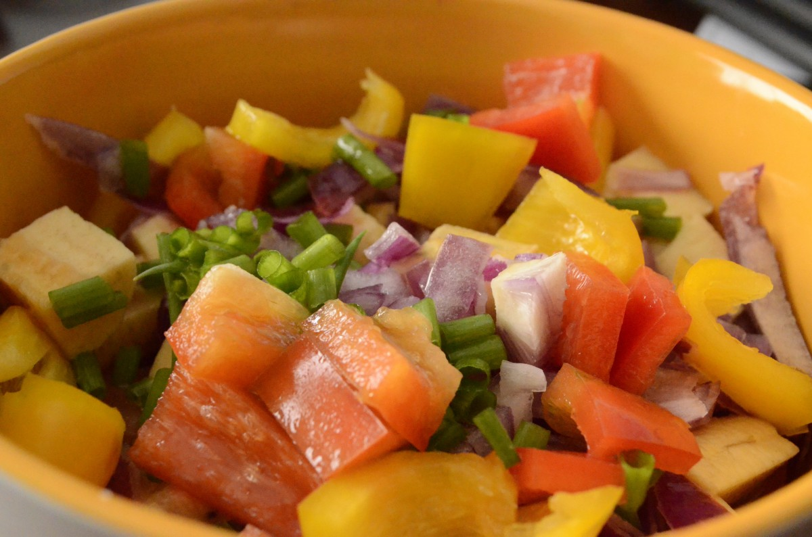
Swap french fries for roasted sweet potatoes fries. Simply cut a whole sweet potato into shoestring pieces, drizzle with extra virgin olive oil, sprinkle with salt and roast at 400F until tender.
Can you think of ways to make your meals and snacks colorful with fruits and vegetables?
Click on each section of the plate for ideas!
Choose water or low fat dairy more often
Add frozen blackberries to your cereal or Greek yogurt for a snack or breakfast.
Change up your usual choices. Grab a bag of mini multi-colored sweet peppers or try swapping your green pepper for a red, purple or yellow bell pepper.
Spoon chicken stir fry over cauliflower rice.
Notes:
You’ve seen this plate in the school cafeteria or in health class. Think of a few meals that you typically eat. Do they include each of the food groups? What is missing and are there things that you could start adding?

Slide 7
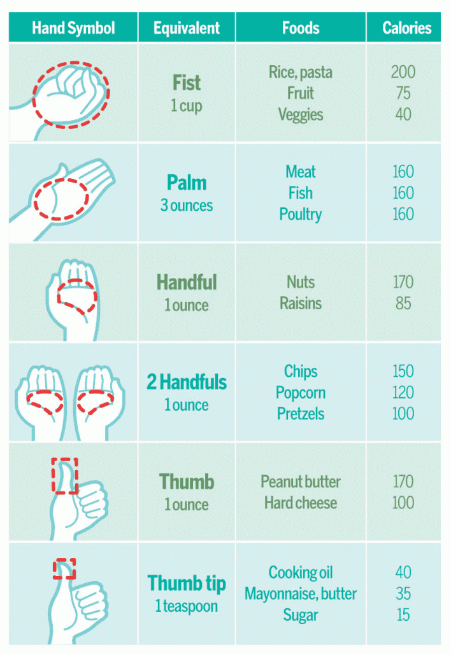
Estimating Your Portion Sizes
Use a 9-inch plate to keep portions in check
Try these hand symbols to gauge portions
Use measuring cups instead of serving spoons when plating food
Read labels for recommended serving size
Notes:
Your hands go with you wherever you go so this a great way to eat healthy portions.

Slide 8
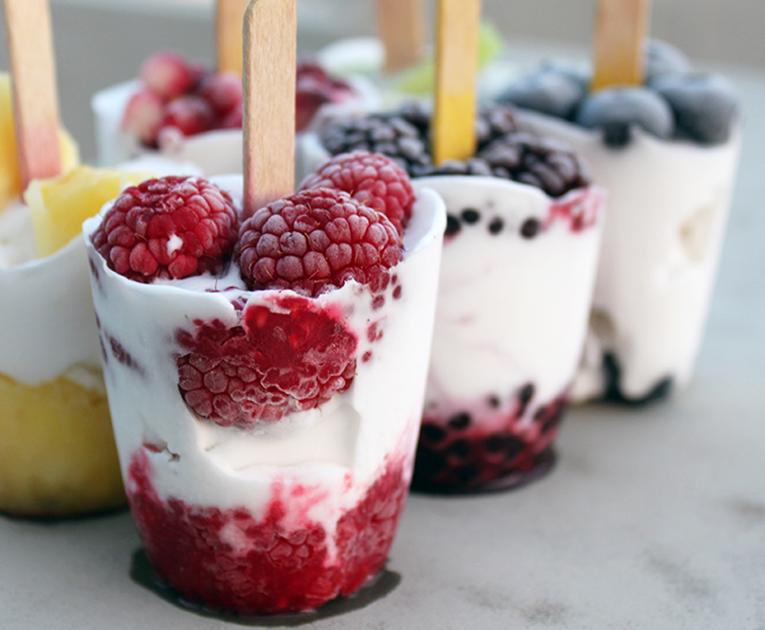
Can I have snacks?
When Should Kids Snack?
Most children and teens need to eat every three to four hours throughout the day to fuel your growing, active bodies and meet your daily needs . This translates into the following:
Younger kids need to eat three meals and at least two snacks a day.
Teens need to eat three meals and at least one snack a day (you may need two snacks if you're going through a growth spurt or if you are very physically active).
Jodie (Jo Ellen) Shield, MED, RD, LD, is co-author of Healthy Eating, Healthy Weight for Kids and Teens from the Academy of Nutrition and Dietetics.
Notes:
Do you usually have snacks in between meals or at bedtime? Do you snack because you are hungry or is it more of a habit? If you are hungry and need a snack, this is another opportunity to get your 5 a day. Consider adding a protein source to help you stay full like cheese, peanut butter or Greek yogurt.

Slide 9
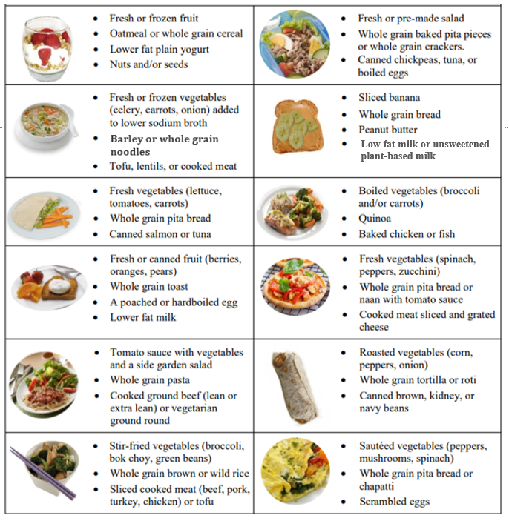
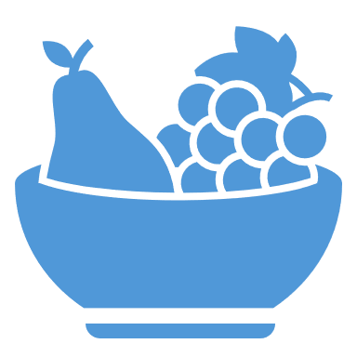
Healthy Meal & Snack Ideas
Making healthy meals can be quick and easy. Try these tips to avoid dining out or take out meals on busy days.
Plan - Planning meals ahead helps you make healthier food choices everyday. It can also help you save time, money and trips to the grocery store. Plan to make simpler meals on busy days using pantry, fridge or freezer staples.
Prepare - Using your weekly menu, begin to prepare meals the night before. Use leftovers, defrost meats in the fridge, and set recipes and tools ahead of time. Have family members take turns helping.
Pack - Right after dinner, start packing lunches for the next day. For extra busy times, pack healthy snacks like whole fruit with yogurt, mixed nuts, carrots with guacamole, cheese stick with whole grain crackers.
Source: Alberta Health Services (Nov 2019)

Slide 10
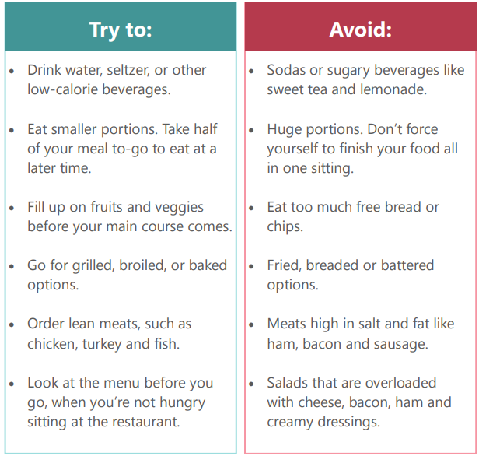
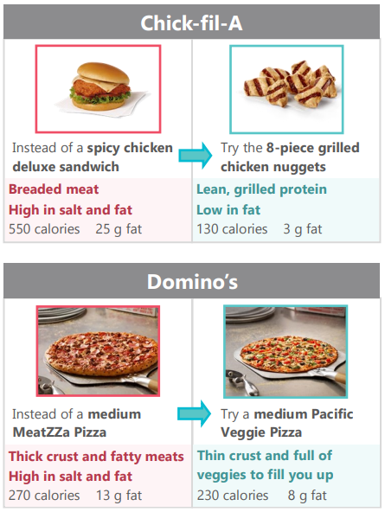
Eating Out Healthy
How to make smart choices at restaurants.
Source: Community Healthcare Network
Notes:
What colors do you see? How many colors can you get on your plate? The more colorful your plate is, the more plant nutrients there are.

Slide 11
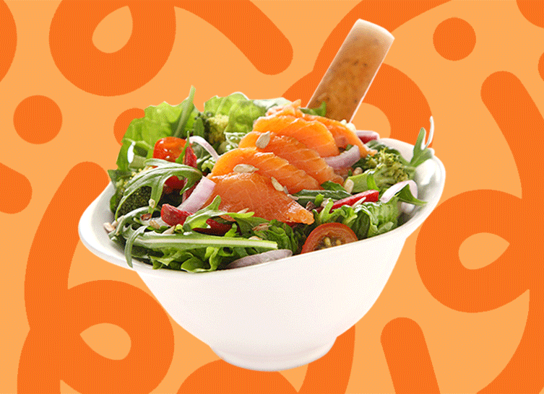
Remember:
Some restaurant foods have extra calories and are high in salt and fat. Eating too much of these foods can put you at risk for certain health problems, such as high cholesterol or high glucose levels.
Source: Community Healthcare Network

Slide 12
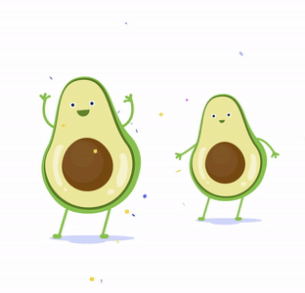
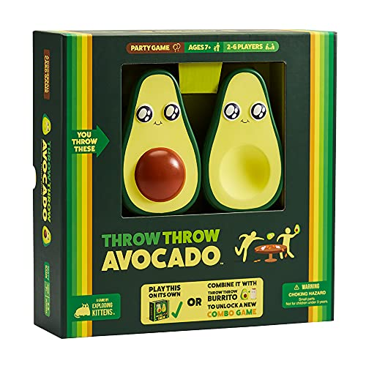
Research shows a direct link between excessive screen time and problems with weight gain.
Find fun activities to do as a family to unplug from your smart phone, smart devices and video games.

Slide 13
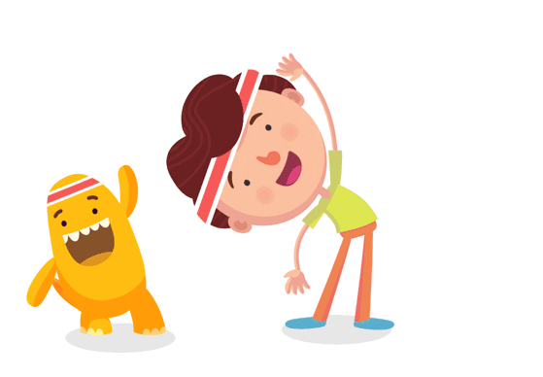
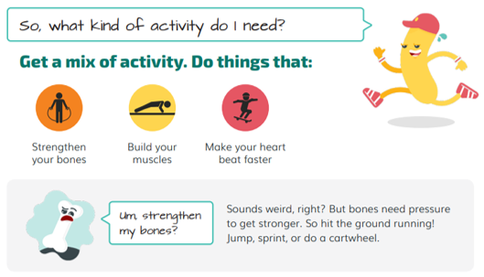
Notes:
What colors do you see? How many colors can you get on your plate? The more colorful your plate is, the more plant nutrients there are.

Slide 14
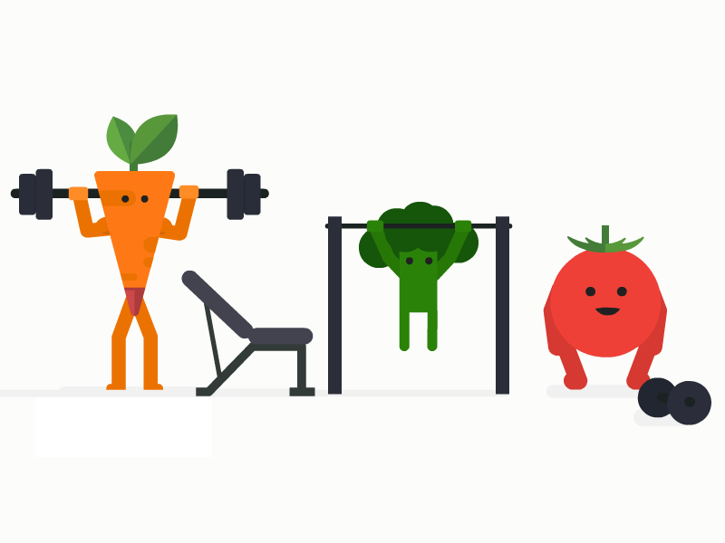
Notes:
What colors do you see? How many colors can you get on your plate? The more colorful your plate is, the more plant nutrients there are.

Slide 15
Most of us eat and drink too much added sugars, which can lead to weight gain and other health concerns. Sugary drinks are the leading source of added sugars in the American diet.
Notes:
The final step in our healthy strategy is 0 sugary drinks. Most of the excess sugar in our diets are hidden in what we drink.

Slide 16
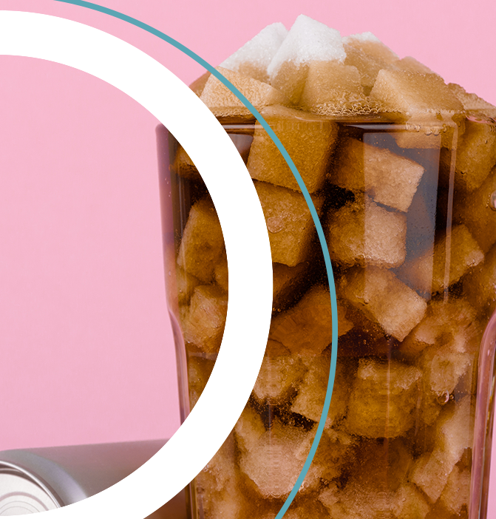
Rethink Your Drink
What are sugary drinks?
Sugary drinks (also known as sugar-sweetened beverages) are any liquids that are sweetened with added sugars. Beverages such as regular soda (not sugar-free), fruit drinks, sports drinks, energy drinks, sweetened waters, and coffee and tea beverages with added sugars are sugary drinks.
Content source: Division of Nutrition, Physical Activity, and Obesity, National Center for Chronic Disease Prevention and Health Promotion

Slide 17
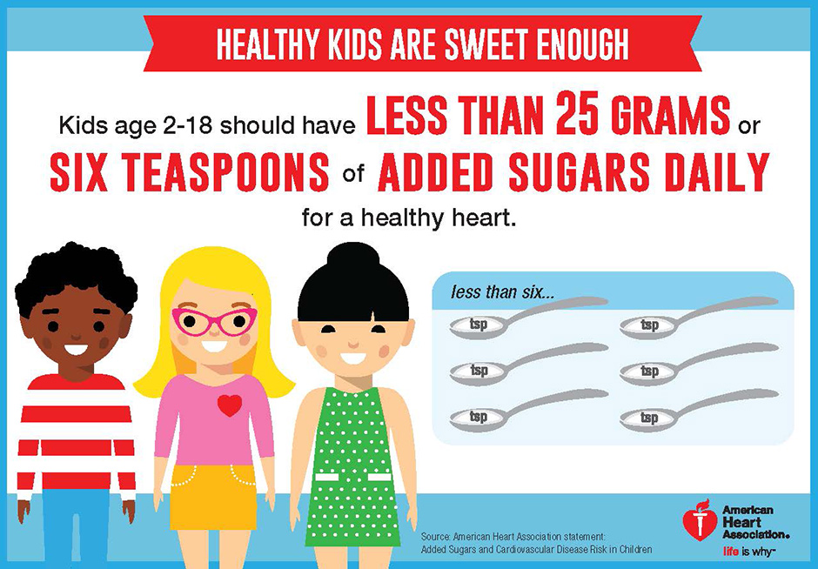
Notes:
What colors do you see? How many colors can you get on your plate? The more colorful your plate is, the more plant nutrients there are.

Slide 18
Tricks To Rethink Your Drink:
Choose water (tap, bottled, or sparkling) over sugary drinks.
Need more flavor? Add berries or slices of lime, lemon, or cucumber to water.
Missing fizzy drinks? Add a splash of 100% juice to plain sparkling water for a refreshing, low-calorie drink.
Need help breaking the habit? Don’t stock up on sugary drinks. Instead, keep a jug or bottles of cold water in the fridge.
Water just won’t do? Reach for drinks that contain important nutrients such as low fat or fat free milk, fortified milk alternatives, or 100% fruit or vegetable juice first.

Slide 19
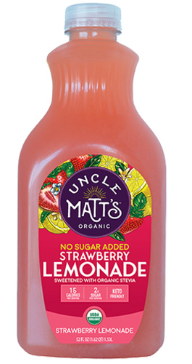
Zero Sugar or No Sugar Added Drink Options
Here are some zero sugar or no sugar added beverages, but don’t forget to drink water often. Avoid caffeinated drinks as much as possible.
Notes:
There are sugar free drinks or flavorings available to add to water like crystal light or mio.

Slide 20
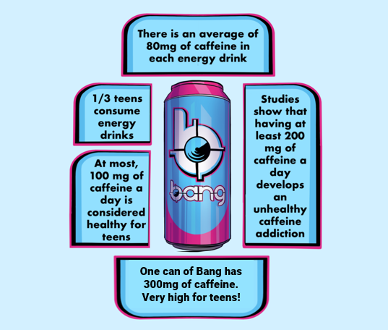
At what age
is caffeine okay?
No amount of caffeine is proven safe for kids 12 and under. And teens should consume
no more than 100 milligrams of caffeine per day.
As for energy drinks?
Just say no to them altogether. Because they’re not regulated by the U.S. Food and Drug Administration (FDA), there’s no way to know for sure how much caffeine is really in them, which can be dangerous for kids and adults alike. In fact, the American Academy of Pediatrics says energy drinks aren’t safe for kids, period.

Slide 21
Start with small changes
Identify how often you’re eating away from home, eating takeout, or eating on the go.
Prepare more meals at home as a family with themes like Meatless Mondays, Taco Tuesday, Wok Wednesday, etc.
Add healthier snacks to the weekly grocery list.
Pick one new change to your meals or beverages to incorporate this week.
Explore various ways the whole family can incorporate more exercise into each day.
Set realistic goals to achieve as a family.

Slide 22
Healthy Resources
Meals and Snacks (eatright.org)
Free Meal Plans Archives - The Real Food Dietitians
40 Healthy Snacks for Hungry Teens (healthline.com)
30+ Healthy Dinner Ideas for Family (eatingwell.com)
Help your kids get more physical activity - Move Your Way | health.gov
Apps
Notes:
What colors do you see? How many colors can you get on your plate? The more colorful your plate is, the more plant nutrients there are.

Slide 23
THANK YOU
Have more questions? Visit our FAQs page.

