Slide 1
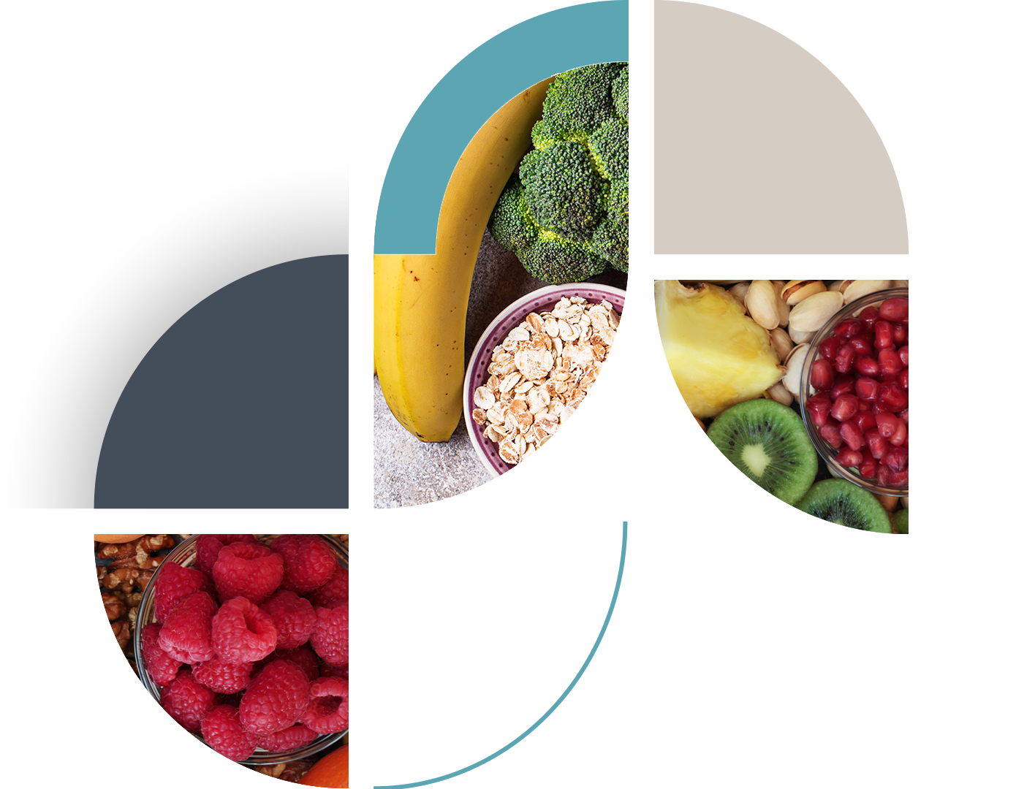

Kelsey-Seybold Healthy Living
Workshop Class 1:
Building Healthy Habits Through Nutrition, Exercise, and Setting Sustainable Goals
KELSEY-SEYBOLD REGISTERED DIETITIANS
Notes:
This workshop is broken down into 3 separate classes to address ways you can create positive lifestyle changes.
We will discuss how and what you eat to fuel your body, ways to add more activity and incorporate exercise into your life and how to make daily meal planning and prepping easier.

Slide 2
Objectives
Define insulin resistance and how it relates to healthy living
Explore groups of food and their effect on health
Meal planning and understanding portion sizes
Rethink your drink- discuss how sugary beverages can lead to significant health problems
Explore ways to incorporate physical activity/exercise into routine
Goal setting to stay motivated and make positive changes

Slide 3

Commit to the Journey not the Destination
Switch from a “Diet” mindset to a “Lifestyle” mindset
  Diets are short-term and can be very restrictive
  Lifestyle is long-term and a constantly evolving approach to eating and exercise
Start Photo By Getty Images
Notes:
You might consider healthy living for the first time, or you may have tried several diets in the past.
It’s so great you’re pursuing better health for yourself – you will benefit in so many ways
Remember to view this as lifestyle change; this should be sustainable and life-long for you

Slide 4

Why Prioritize Your Health
Improved
Self-worth
Quality of Life/
Independence
Disease
Prevention
Longevity
We feel good about ourselves when we focus on our self-care.
This is a no brainer.
Maintain your current level of independence for as long as possible.
Instead of assuming you’re going to
develop a certain disease, let it
motivate you to make changes toward prevention.
Notes:
Knowing what we should do for a healthy lifestyle is important, but it’s important to understand your why. You might relate to some of these examples, but here are some ideas to get you started thinking about why you want to change.

Slide 5
Why Prioritize Your Health
Positive Impact of Others
Increase
Energy
Better Sleep
Improved
Digestion
If you start eating healthier, exercising, working on cutting back on stress, it will rub off
on others around you.
Exercise will help you fall asleep easier when you are fatigued from exertion.
Also managing your stress and anxiety will greatly improve your sleep.
Poor diet messes
with digestion. Stress messes with digestion.
Regular exercise and healthy, well-balance diet can help improve digestion.
Yes!
Please!

Slide 6
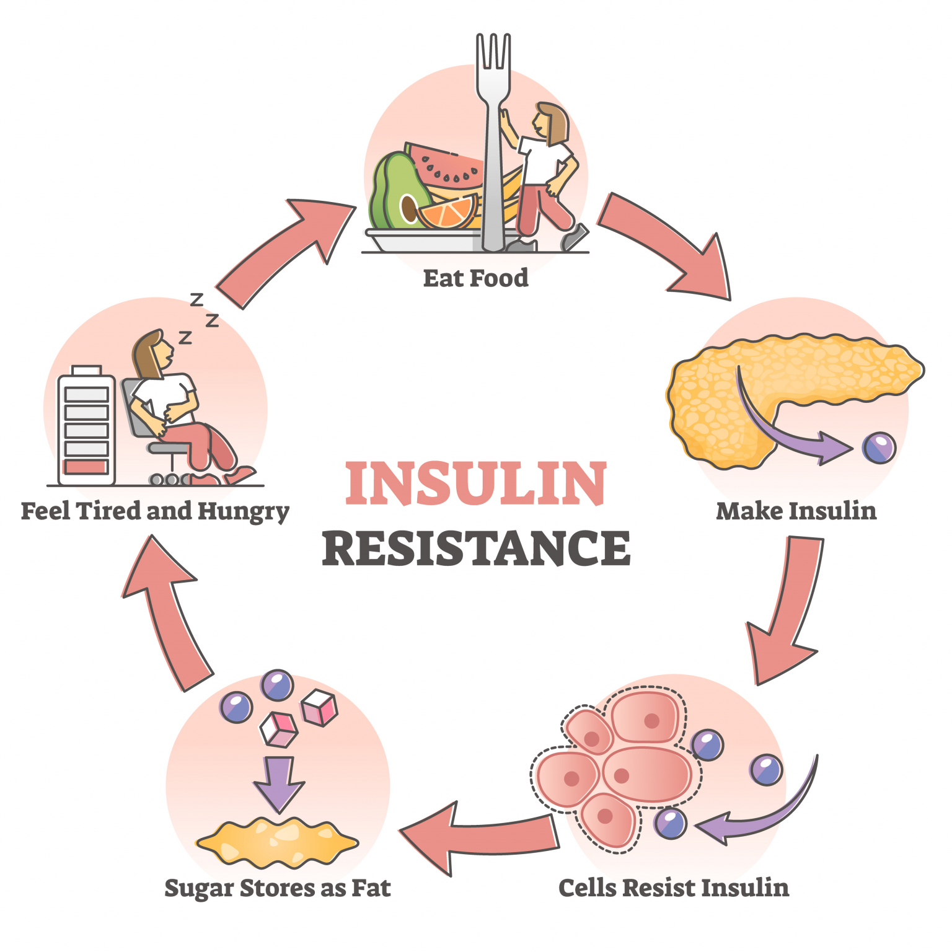
What is insulin resistance?
Notes:
One benefit of healthy living is the prevention of Insulin Resistance and several other chronic diseases
What is insulin resistance?
Insulin resistance is when cells in your muscles, fat, and liver don’t respond well to insulin and can’t easily take up glucose from your blood.
Prediabetes is also known as insulin resistance. When you eat carbohydrate foods, your body actually makes excess insulin because the cell’s in your body are not responding. Insulin is a storage hormone and the excess stores carbohydrate (sugar) as fat. This can leave you feeling fatigued and actually more hungry making you want to eat again and repeating the cycle. Researchers don’t fully understand what causes insulin resistance and prediabetes, but they think excess weight and lack of physical activity are major factors. (Source: CDC)

Slide 7
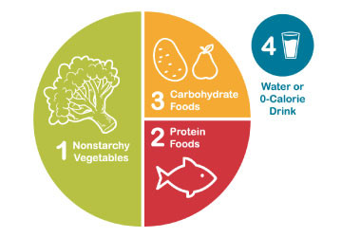
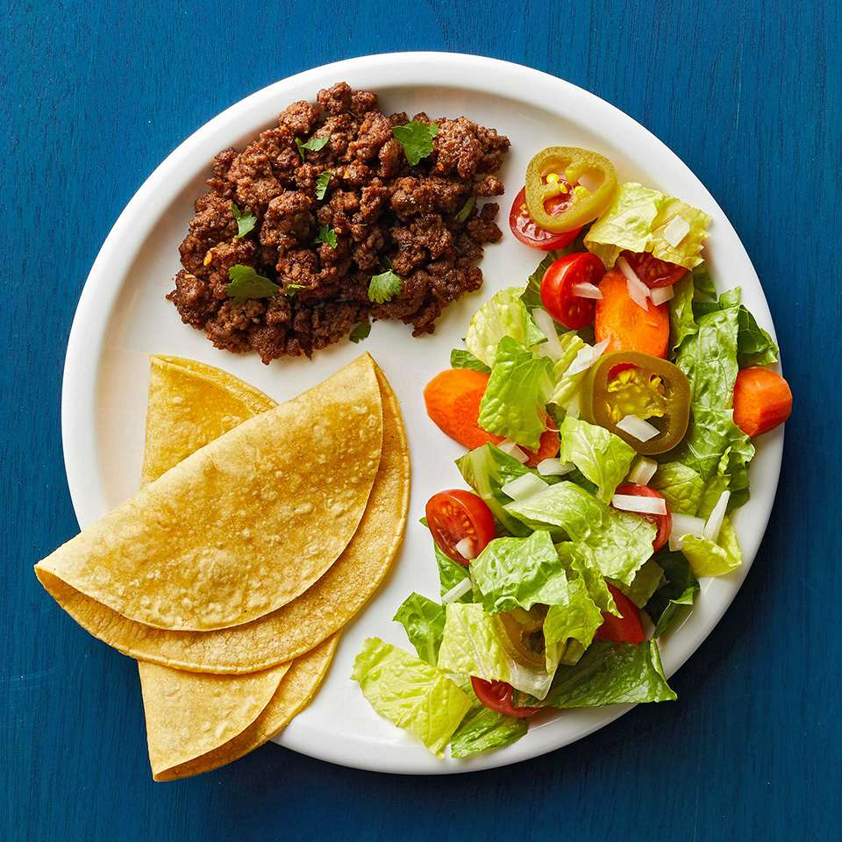
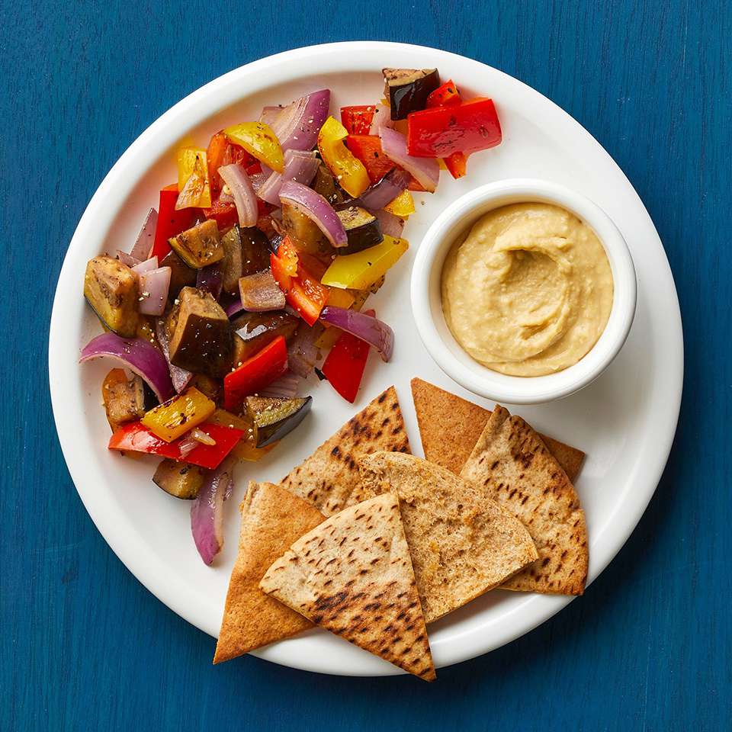
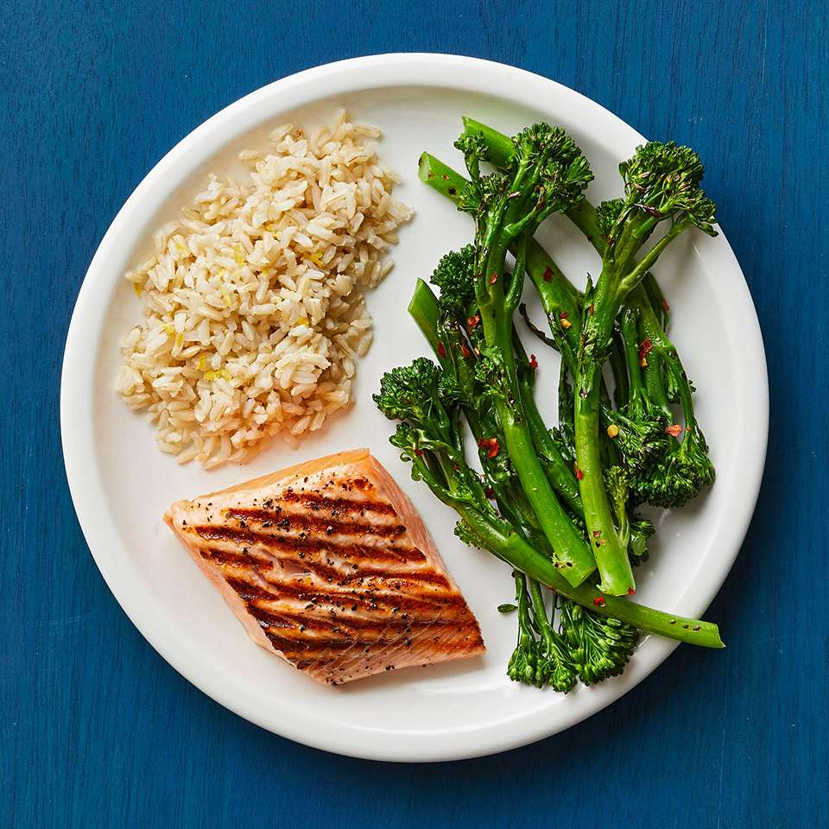
Meal Planning with The Plate Method
Fill half of your plate with non-starchy vegetables
Fill ¼ plate with 1 cup of starch/grain/fruit
Fill ¼ plate with 3-4 ounces of protein
Drink water or another beverage without sugar
Pictures by American Diabetes Association
Notes:
We can begin with how best to fuel your body.
Here are 4 components that make up our diet. It’s important to include non-starchy vegetables whenever available because it will naturally portion control the carbohydrate and protein foods we usually always eat.
Drinking more water than any other beverage is also important for our health.

Slide 8
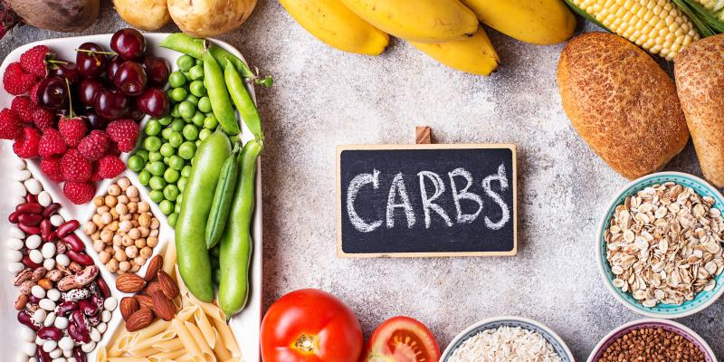
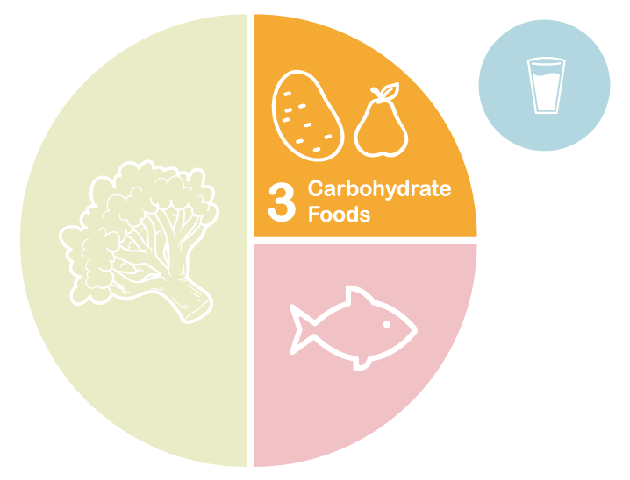
Carbohydrates are foods that provide energy but can also elevate glucose
This includes:
Grains
Starchy vegetables
Fruits
Milk
Sweets
Pictures by American Diabetes Association
Notes:
Carbohydrate foods turn to sugar in the body which is used for energy or fuel for the cells. If our cells are active they can burn this sugar or they can store it as fat for the future.

Slide 9
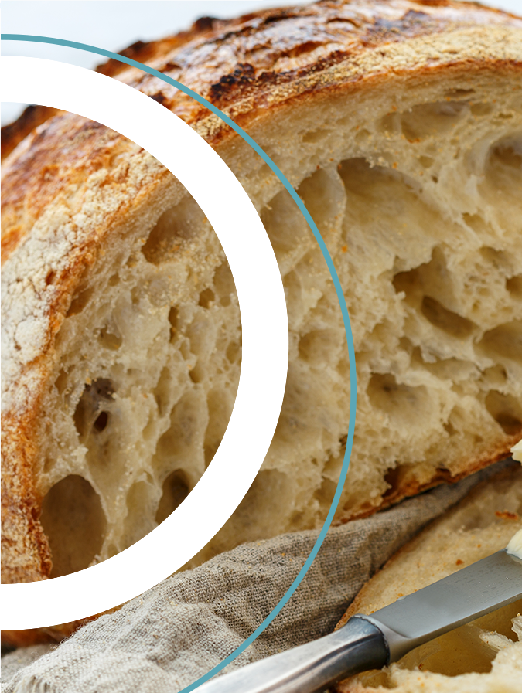
One Serving Of Grains Or Starchy Vegetables
1 Slice of bread
1 Tortilla
¾ Cup cold cereal
½ Cup oatmeal or grits
⅓ Cup pasta or rice or quinoa
½ Cup potatoes or corn or beans

Slide 10
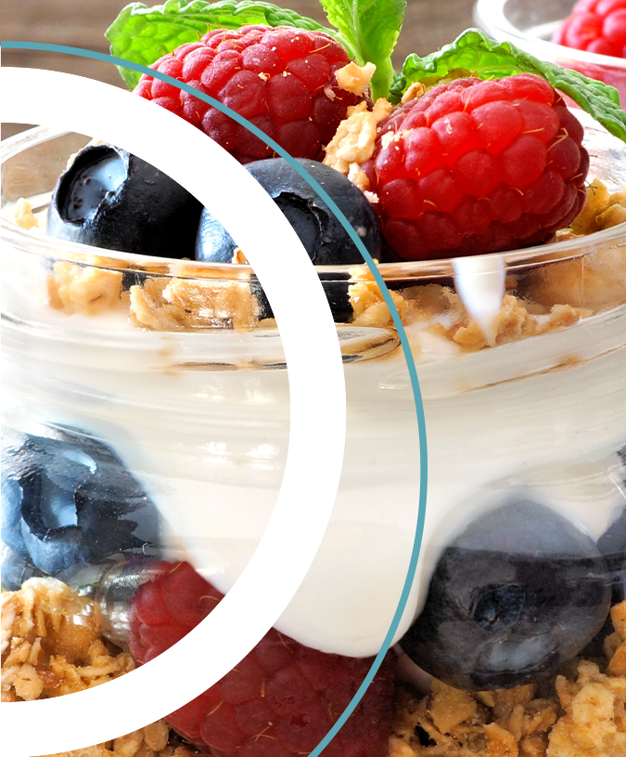
One Serving Of Fruit And Dairy
1 small piece of fruit
1 cup berries or melons
2 tablespoons of raisins
1 cup of cow milk
1 cup of soy milk
2 cups almond or coconut milk
1 cup yogurt (plain or no added sugar)

Slide 11
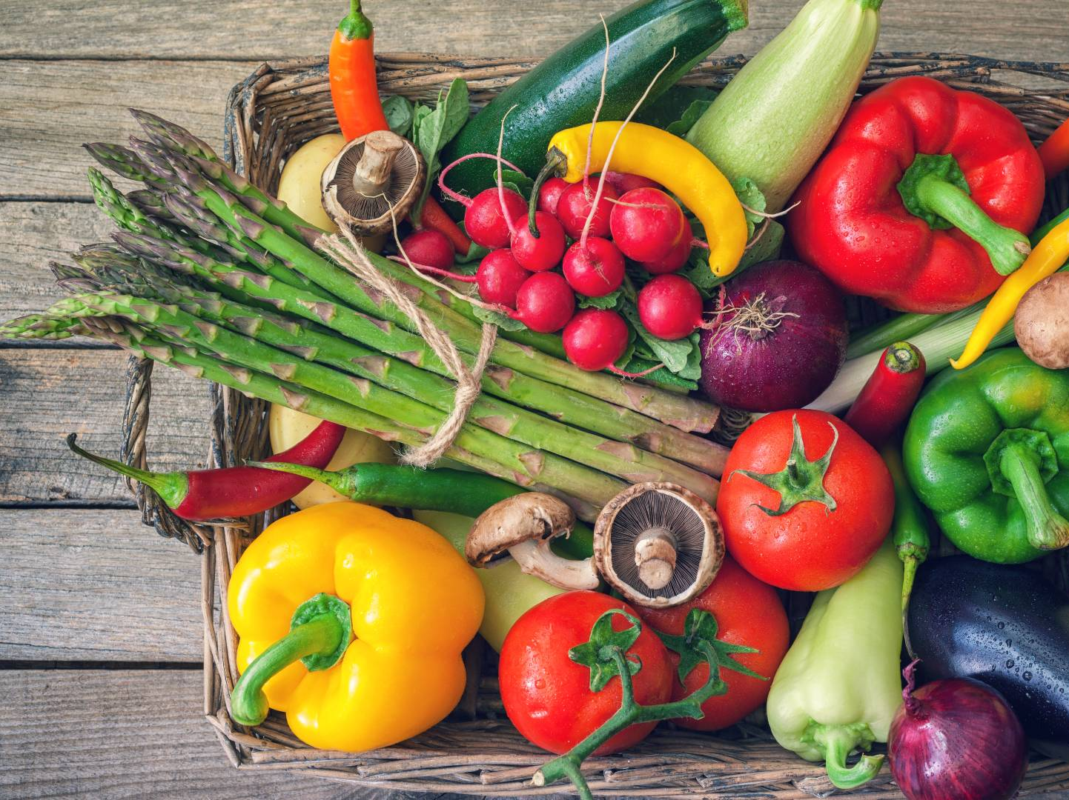
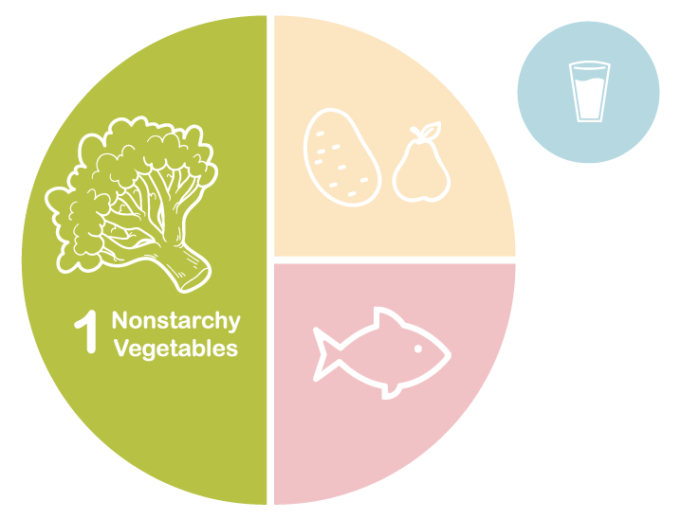
Non-Starchy Vegetables
Contain a small amount of carbohydrate but also have protein and fiber. They are low in calories and do not increase glucose level. Strive for 3-5 servings per day.
One serving=1 cup raw or ½ cup cooked.
Plate Method by American Diabetes Association
Vegetable Photo by Getty Images
Notes:
Vegetables are high in dietary fiber which promotes fullness. They also give us vitamins, minerals and are low in calories and sugar. They do contain a small amount of protein.
The goal is to eat more!

Slide 12
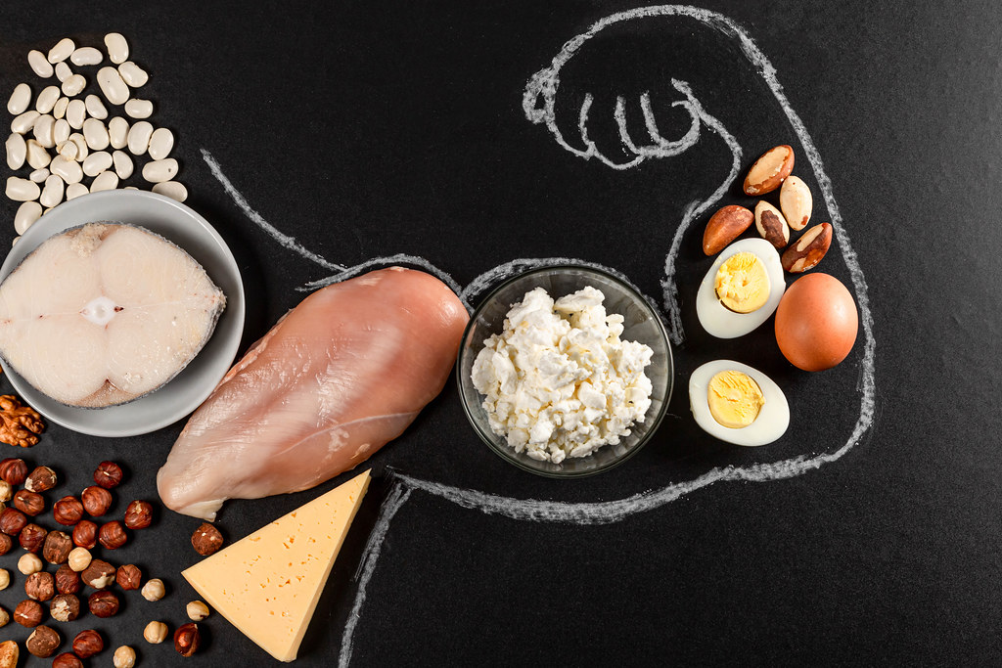
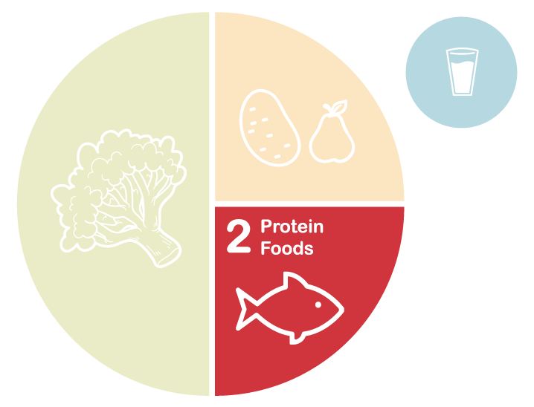
Proteins helps repair and build your body’s tissues. It can also help slow down the absorption of sugar when consumed with carbohydrate foods
Good sources include lean beef, poultry, seafood, lamb and wild game
Eggs
Cheese
Nuts
Nut butters
Tofu
Plate Method by American Diabetes Association
Protein Photo by Unknown Author is licensed under CC BY-SA-NC
Notes:
Protein slows the absorption of sugar into the body so it will keep blood sugar more stable and it will keep you full longer.

Slide 13
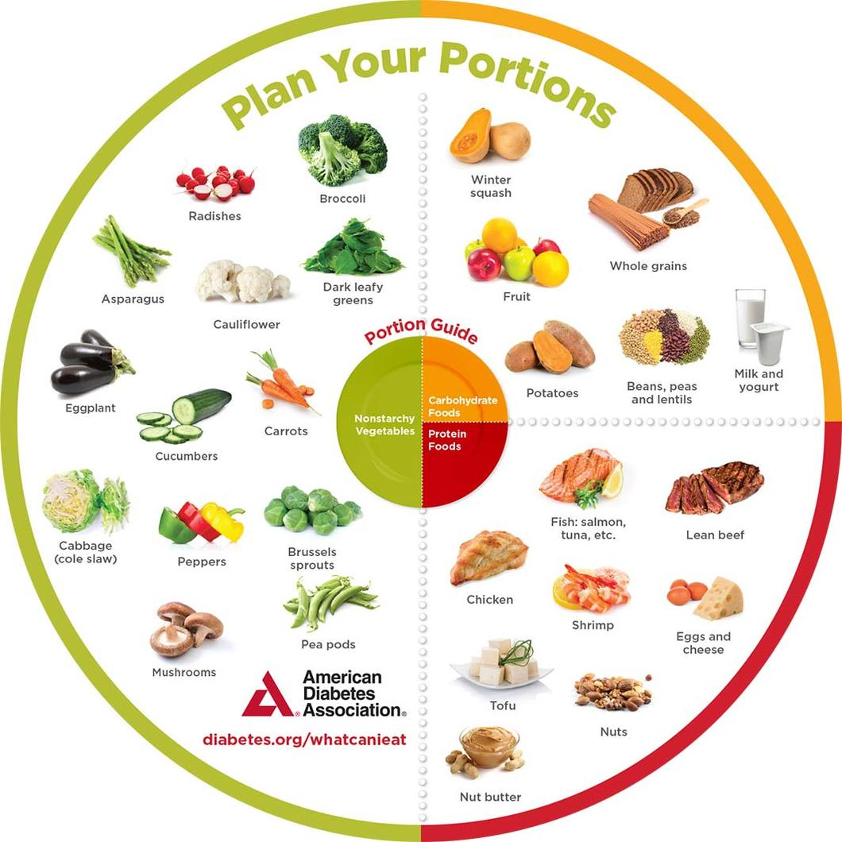
Notes:
Going back to the plate method to plan our meals, portion sizes of foods are important.
Your plate should not be bigger than your 2 hands or a 9 inch plate.

Slide 14
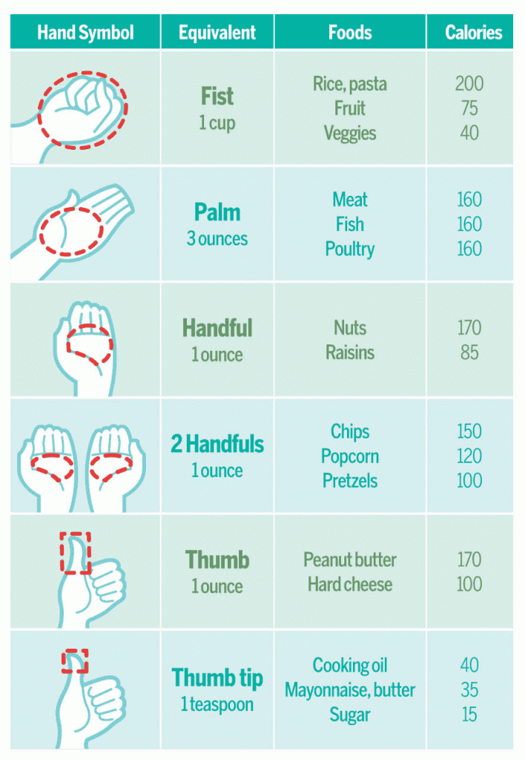
Estimating Your Portion Sizes
Use food tracking apps like My Fitness Pal, Lose It or Carb Manager
Read labels for recommended serving size
Use a 9-inch plate to keep portions in check
Use measuring cups instead of serving spoons when plating food
Notes:
Your hands are always with you so you always have the ability to portion control.
Your fist is about 1 cup of food. Think of having 4 fists on your plate.
2 fist sizes = vegetables
1 fist = carbohydrate
1 fist or palm size = protein
Limit added oil or butter to thumb tip or teaspoon.

Slide 15
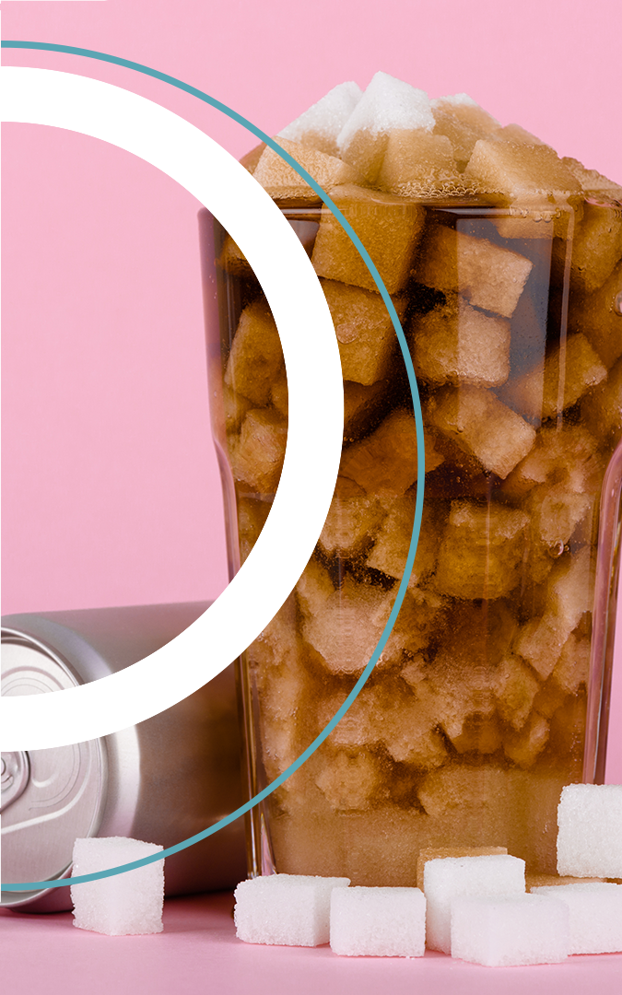
Rethink Your Drink
Most of us eat and drink too many added sugars, which can lead to significant health problems. Sugary drinks are the leading source of added sugars in the American diet.
What are sugary drinks?
Sugary drinks (also known as sugar-sweetened beverages) are any liquids that are sweetened with added sugars. Beverages such as regular soda (not sugar-free), fruit drinks, sports drinks, energy drinks, sweetened waters, and coffee and tea beverages with added sugars are sugary drinks.
Content source: Division of Nutrition, Physical Activity, and Obesity, National Center for Chronic Disease Prevention and Health Promotion
Notes:
There is a lot of sugar that hides in what we drink and this liquid sugar will quickly elevate blood sugar which elevates insulin level and can contributes to weight gain.

Slide 16

Rethink Your Drink
Most of us eat and drink too many added sugars, which can lead to significant health problems. Sugary drinks are the leading source of added sugars in the American diet.
Why should I be concerned about sugary drinks?
People who often drink sugary drinks are more likely to face health problems, such as weight gain, obesity, type 2 diabetes, heart disease, kidney diseases, non-alcoholic liver disease, tooth decay and cavities, and gout, a type of arthritis.
Content source: Division of Nutrition, Physical Activity, and Obesity, National Center for Chronic Disease Prevention and Health Promotion
Notes:
There is a lot of sugar that hides in what we drink and this liquid sugar will quickly elevate blood sugar which elevates insulin level and can contributes to weight gain.

Slide 17
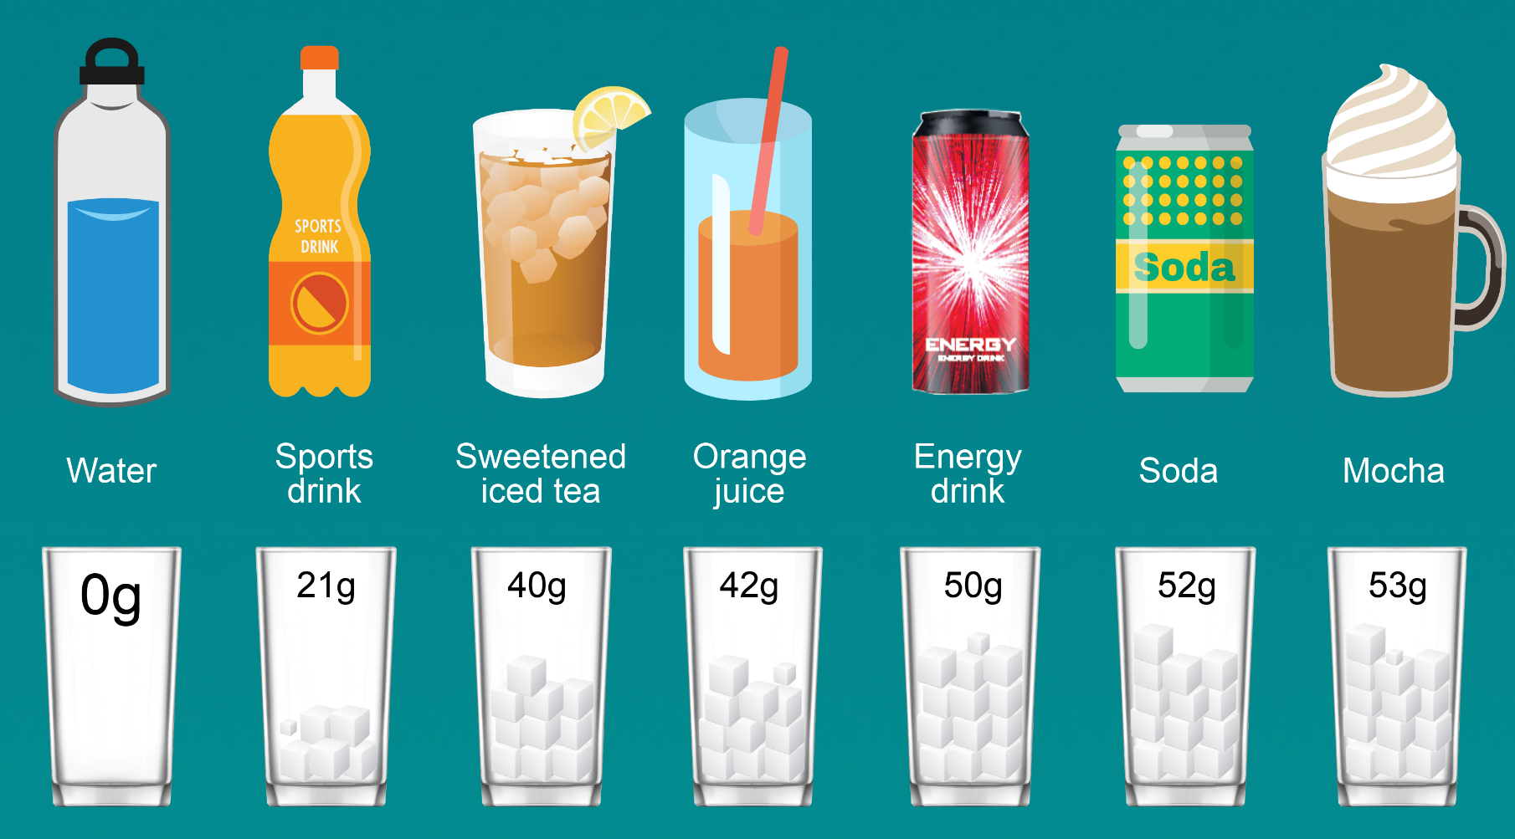
Notes:
Here are amounts of sugar in popular drinks.
1 tsp sugar = 5 grams.

Slide 18

Tricks To Rethink Your Drink:
Choose water (tap, bottled, or sparkling) over sugary drinks.
Need more flavor? Add berries or slices of lime, lemon, or cucumber to water.
Missing fizzy drinks? Add a splash of 100% juice to plain sparkling water for a refreshing, low-calorie drink.
Need help breaking the habit? Don’t stock up on sugary drinks. Instead, keep a jug or bottles of cold water in the fridge.
Water just won’t do? Reach for drinks that contain important nutrients such as low fat or fat free milk, fortified milk alternatives, or 100% fruit or vegetable juice first.
Notes:
Water is the best way to stay hydrated. Start with 64 ounces (1/2 gallon) and increase if you need more.
Ways to stay consistent include:
infusing water with lemon, berries, cucumber or other fruits.
Trying sparkling flavored waters.
Keep a reusable cup with you to refill and also to keep your water the temperature you prefer.

Slide 19

Tricks To Rethink Your Drink:
Choose water (tap, bottled, or sparkling) over sugary drinks.
At the coffee shop? Skip the flavored syrups or whipped cream. Ask for a drink with low fat or fat free milk, a milk alternative such as soy or almond, or get back to basics with black coffee.
At the store? Read the Nutrition Facts Label to choose drinks that are low in calories, added sugars, and saturated fat.
On the go? Carry a reusable water bottle with you and refill it throughout the day.
Still thirsty? Learn how to drink more water.
Remember that you can be a role model for your friends and family by choosing water and other healthy, low-calorie beverages.
Notes:
Water is the best way to stay hydrated. Start with 64 ounces (1/2 gallon) and increase if you need more.
Ways to stay consistent include:
infusing water with lemon, berries, cucumber or other fruits.
Trying sparkling flavored waters.
Keep a reusable cup with you to refill and also to keep your water the temperature you prefer.

Slide 20

Increase Daily Activity
Find ways to move more throughout the day
Start with 10 minutes of activity and do it several times each day
Walk the dog
Park further from where you are going
Track your steps
Notes:
Thanks to modern conveniences, we don’t move throughout the day as much as previous generations. The average amount of daily steps 50 years ago was around 12,000 per day. Today the average step count is 3000-4000 per day. According to the National Institutes of Health, 8000 steps or more per day reduces your risk of death over the next decade compared to those that only walk 4000 steps per day. Try breaking up sitting more than 1-2 hours and build more movement into everything you do throughout the day.

Slide 21

Are you Ready for Change?
Transtheoretical model (TTM). The idea is that people move from one stage to the next. Each stage is a preparation for the following one, so hurrying through or skipping stages is likely to result in setbacks.
Change is a process… it is not linear
It takes action to stay motivated.
Notes:
Making changes to our daily life is a process and will not be a perfect path.
We are good at gathering knowledge and thinking about a plan but it takes action to stay movitated.

Slide 22
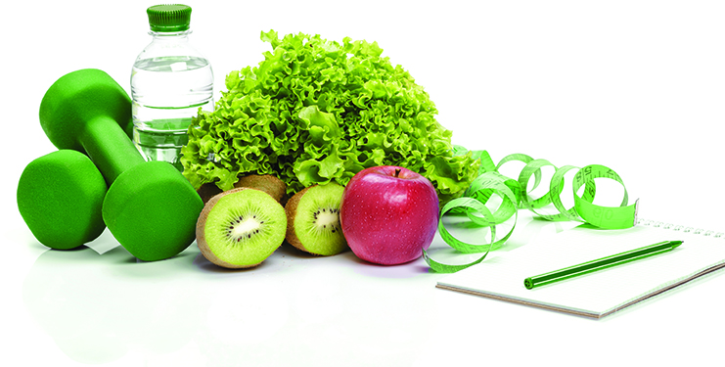
Know Where You Are Starting
What stage of change are you in?
Preparation:
Track all food and beverages you eat along with the portions in a diary or phone app
Identify how often you’re eating away from home, eating takeout, or eating on the go
Track your daily steps and sleep patterns using your phone app or good ole pen and paper journal
Notes:
Begin with understanding what your daily habits are over a few weeks. Track what you eat, drink, activity and sleep.
Once you see what your daily habits are that got you here today, you can create actionable goals you can act on each day to make long term change.

Slide 23
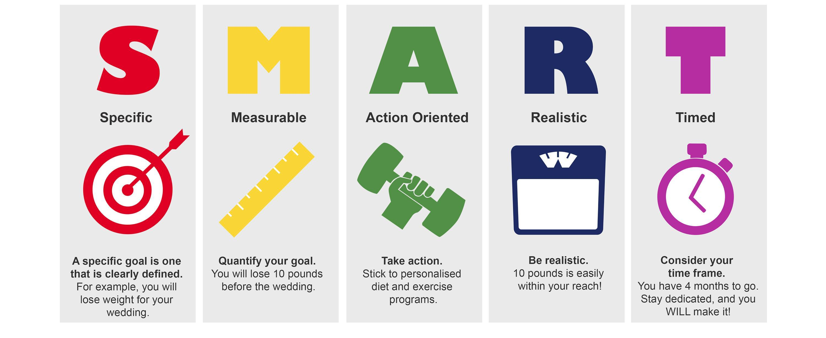
Set SMART Goals
Notes:
Think of a few specific goals that you can measure and act on. Give yourself a realistic time frame to meet your goal and then break it down to smaller daily actions to achieve the goal.
It is important to write this down to create a written contract with yourself. And the act of writing starts the action that is needed to create motivation.

Slide 24
THANK YOU
KELSEY-SEYBOLD REGISTERED DIETITIANS

