Slide 1
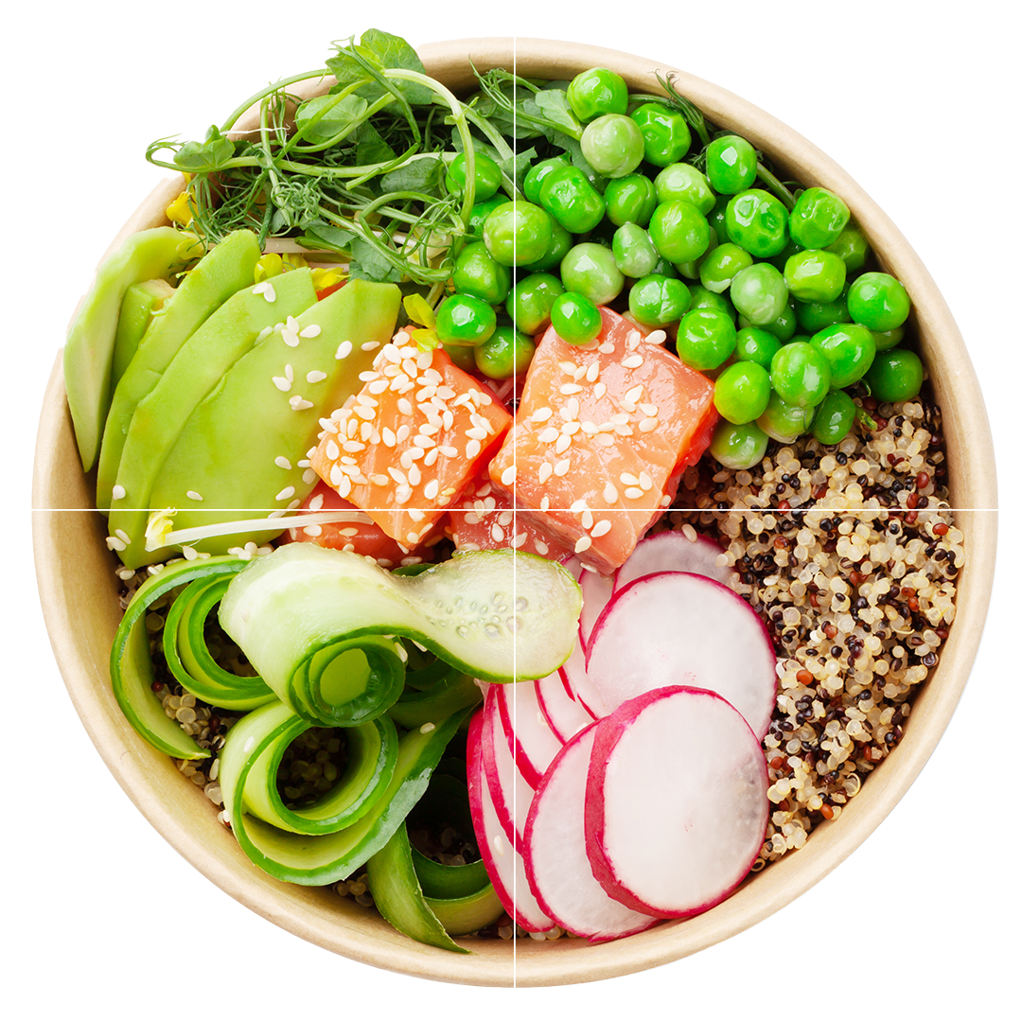
Kelsey-Seybold Healthy Living
Workshop Class 3: Mindful Eating and Meal Planning for a Healthy Lifestyle
KELSEY-SEYBOLD REGISTERED DIETITIANS

Slide 2
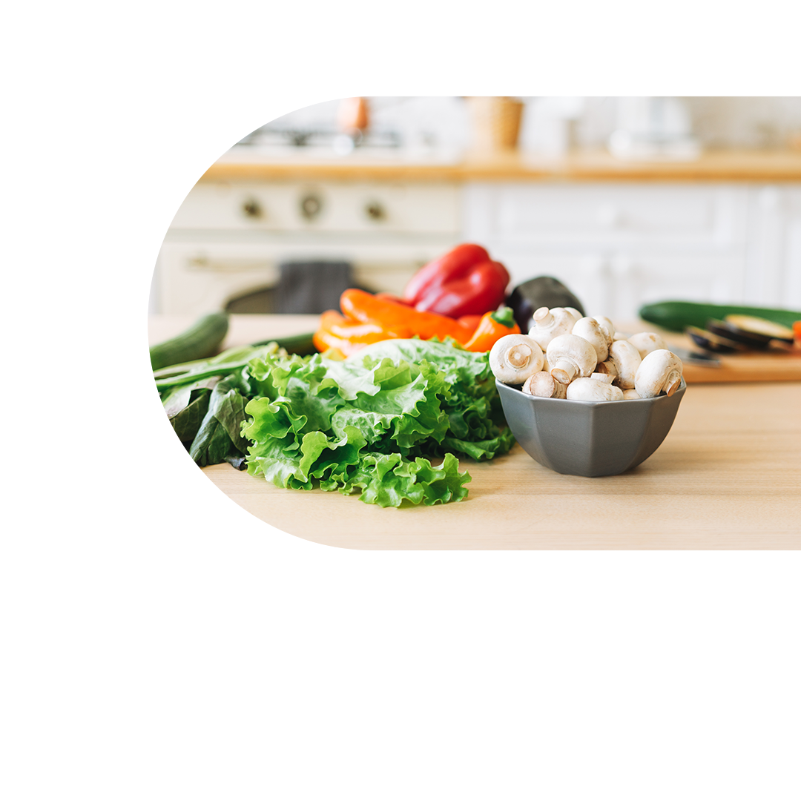
Objectives
Review Activity/Exercise Goals
Review My Plate
Highlight nutrient rich foods
Provide tools for healthy eating:
Meal planning tips
Recipe resources
Grocery shopping advice
Eating better when eating out

Slide 3
Goals for Activity and Exercise
Aim for 10,000 steps/day
Move for a few minutes every hour to avoid prolonged sitting
Exercise goals:
Cardio/aerobics: 150 minutes/week or 30 minutes 5 days/week
Strength training 2-3 days/week working major muscle groups
Stretching or balance exercises daily, or 3x/week

Slide 4
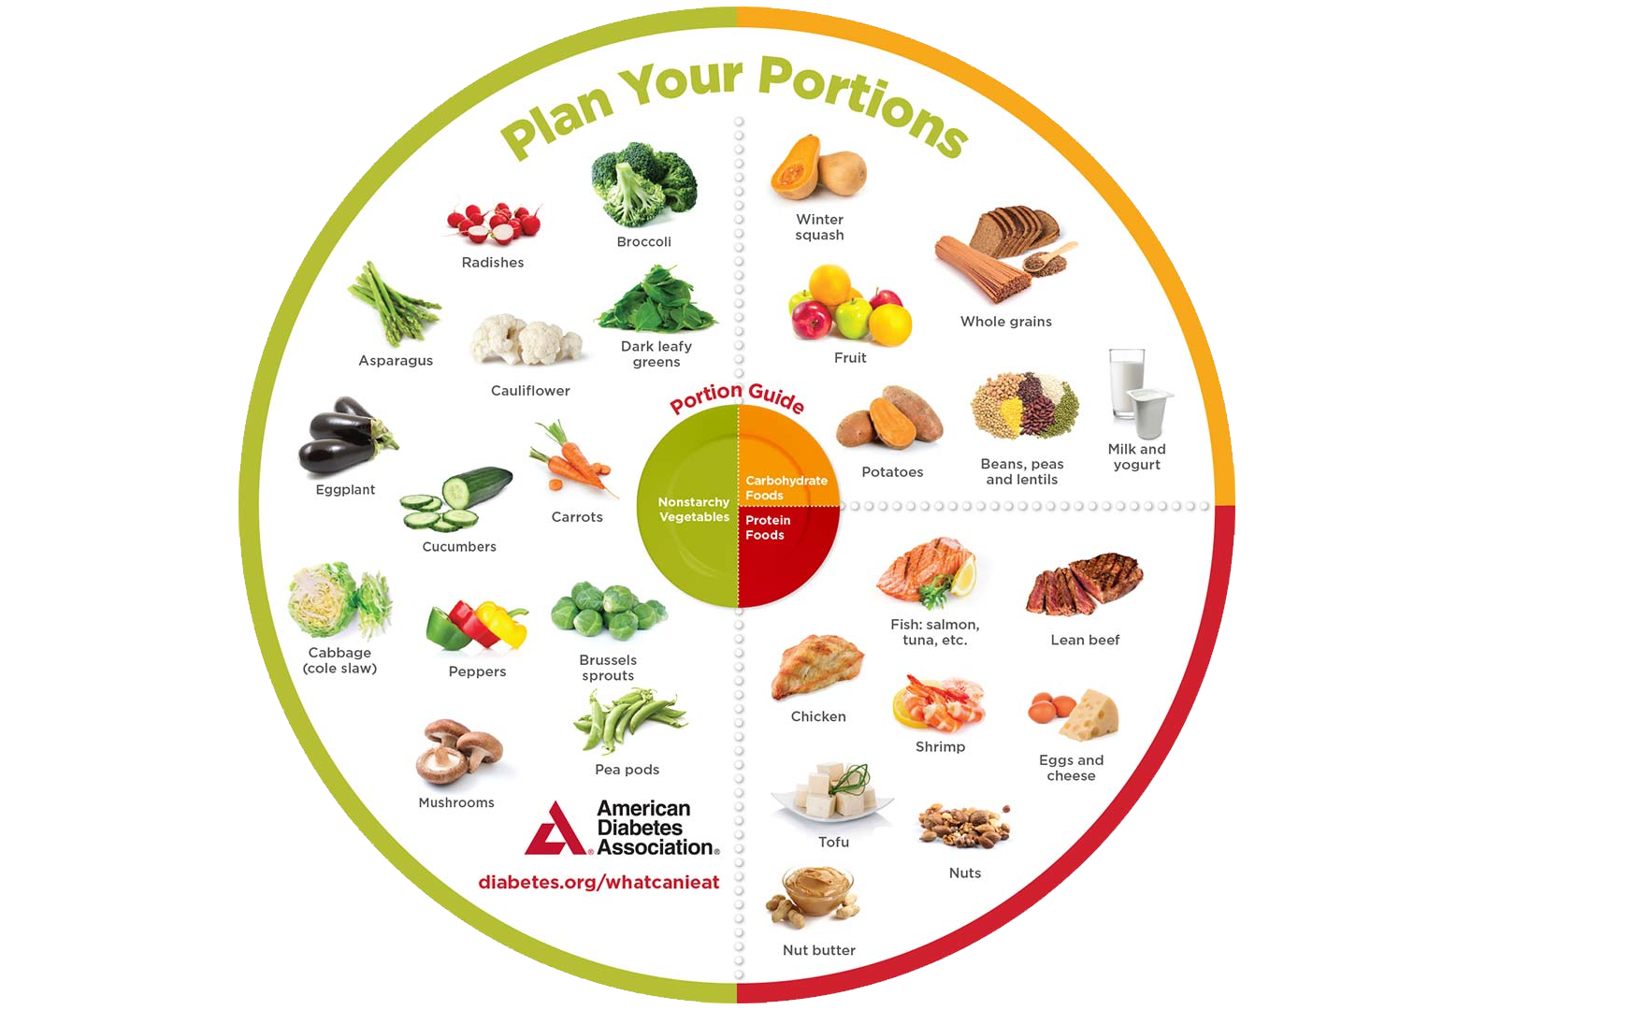

Slide 5
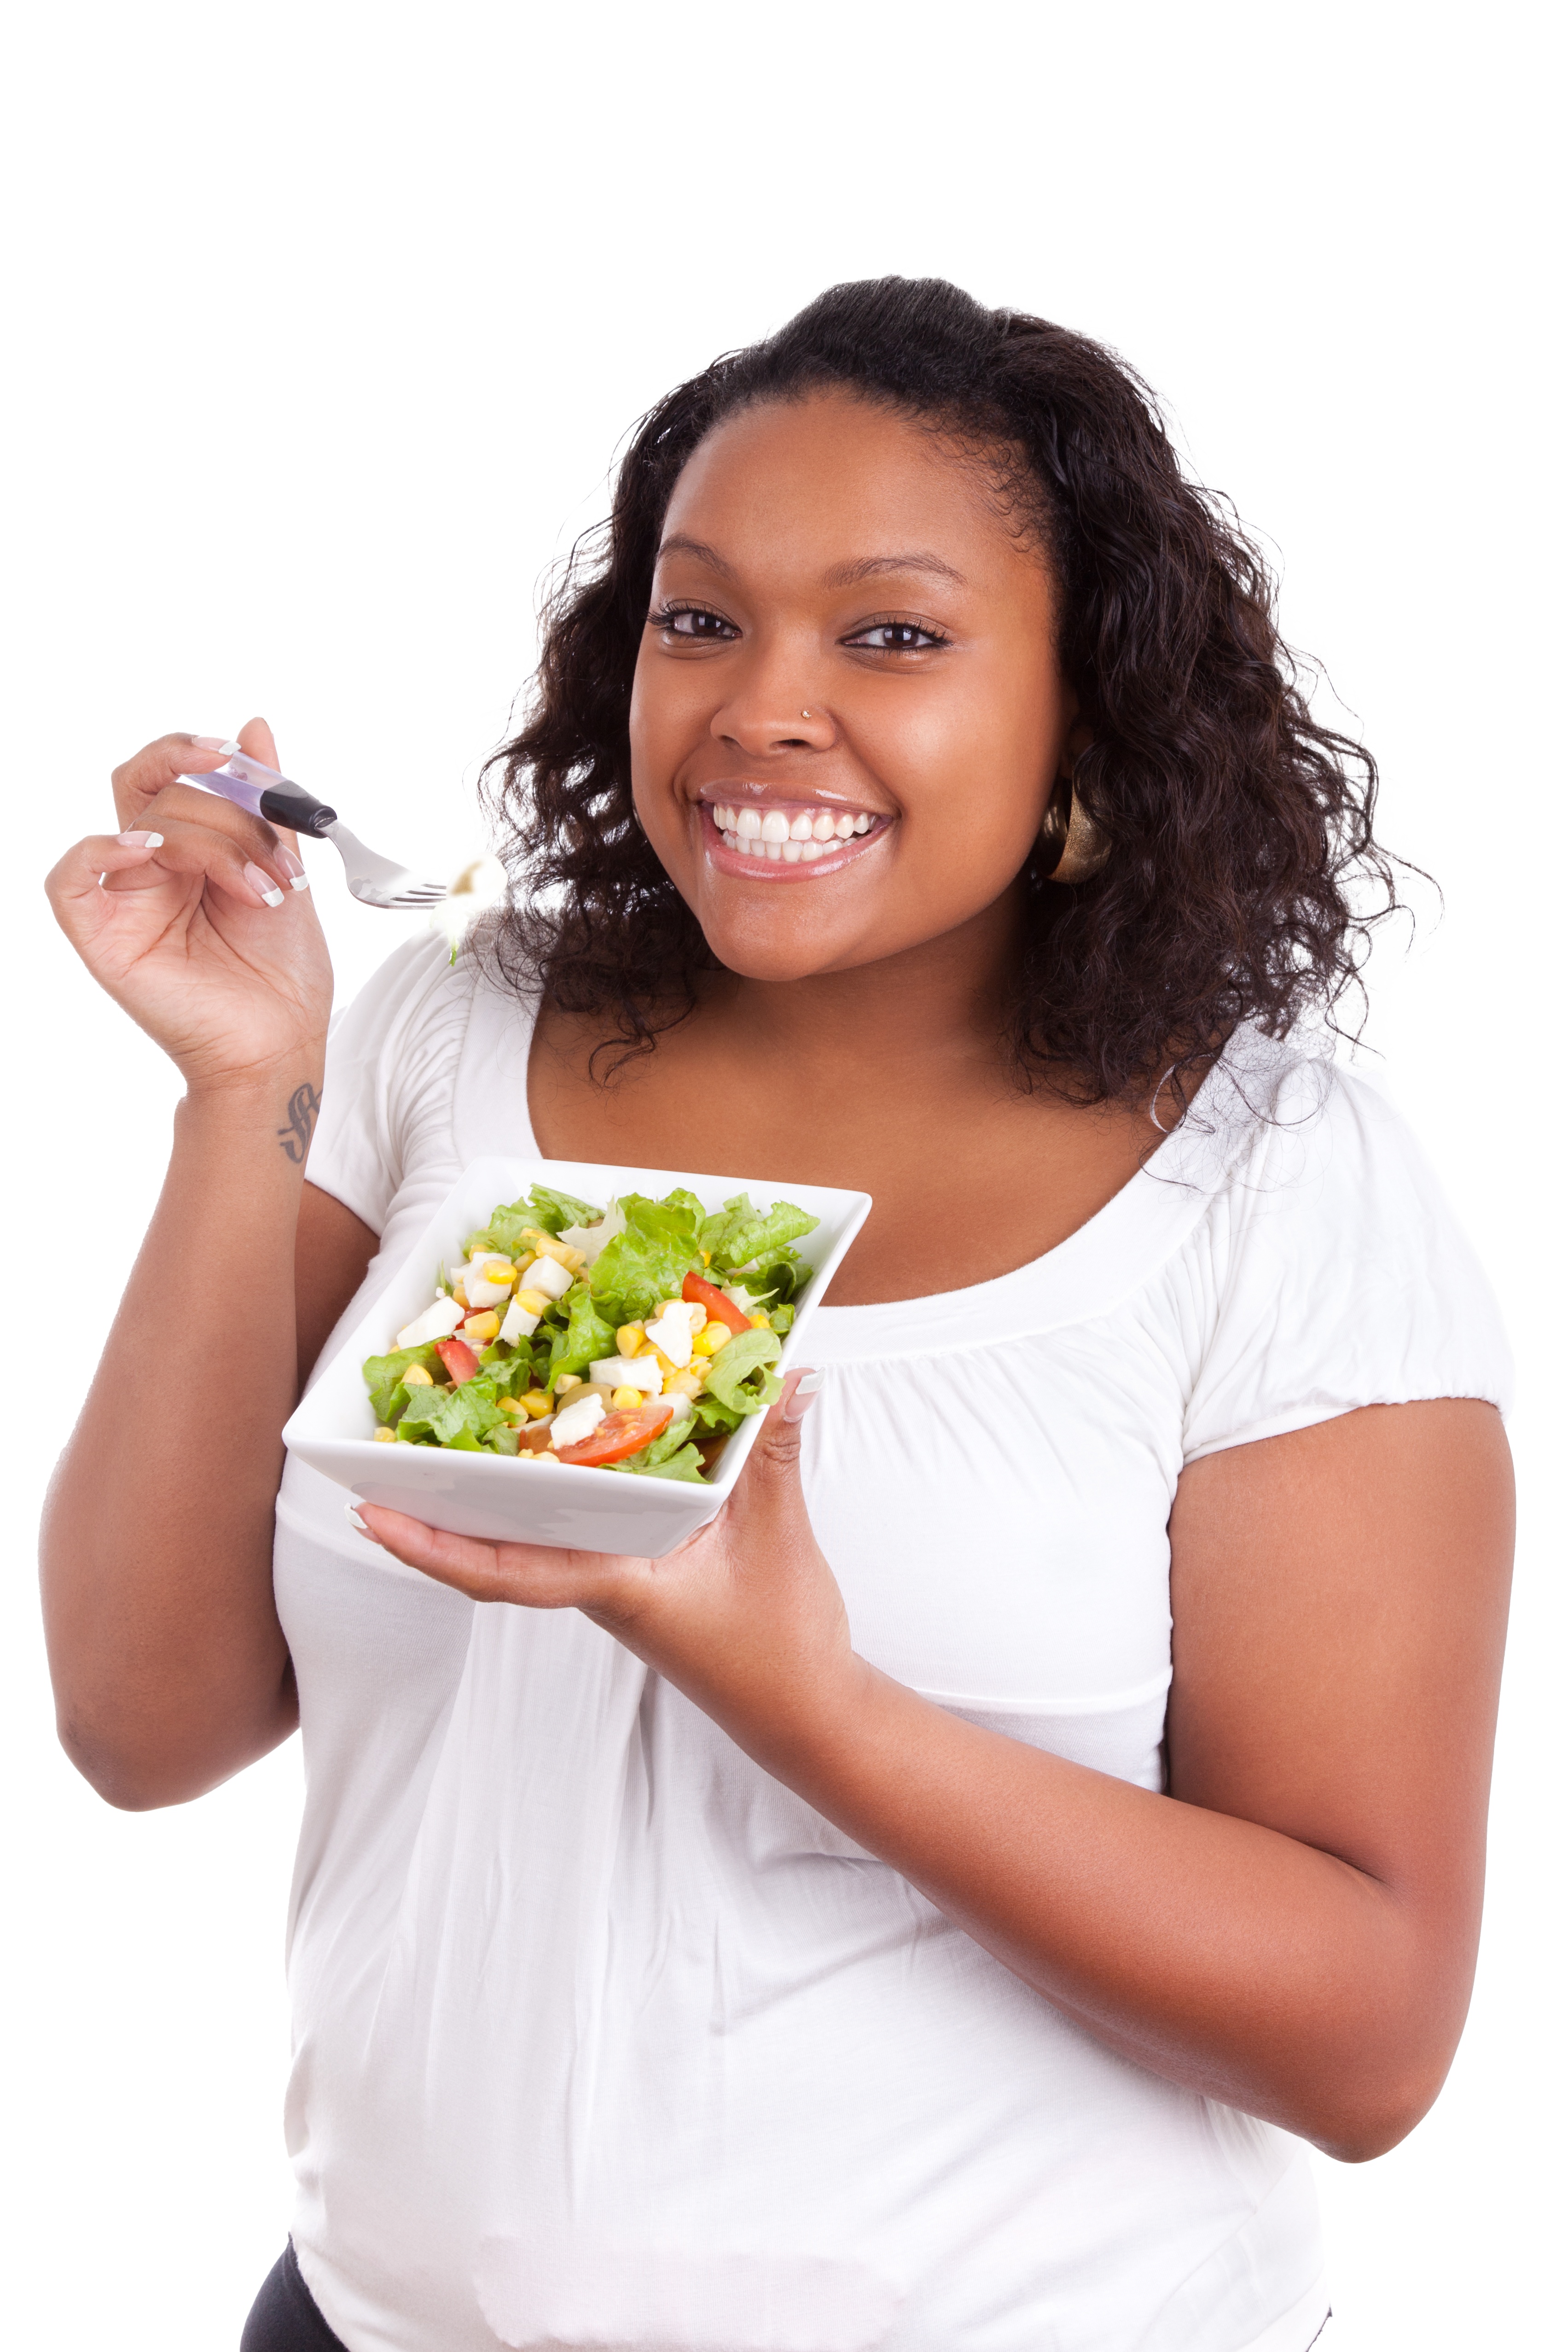
Healthy Eating
Work towards a balanced My Plate at meals
Choose snacks with a source of protein and plants (fruits or vegetables)
Know what you will eat before you get too hungry
Choose foods that are nutrient rich

Slide 6
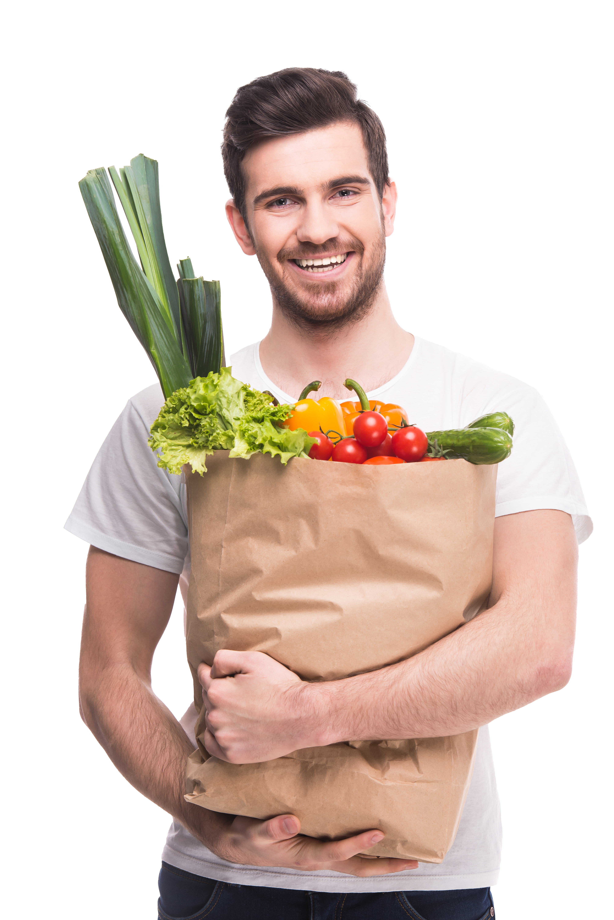
Nutrient Dense Foods - Plants
Choose a variety of colors and textures
Plant-based proteins
Beans
Lentils
Soy foods
Whole Grains
Whole wheat
Oatmeal
Brown/wild rice
Nuts & seeds
All nuts
Nut butters
Chia, Flax, Sunflower seeds, Pumpkin seeds
Vegetables
Fresh
Frozen
Low-sodium canned
Fruits
Fresh
Frozen
Canned in 100% juice
Plant oils
Olive
Avocado
Canola

Slide 7
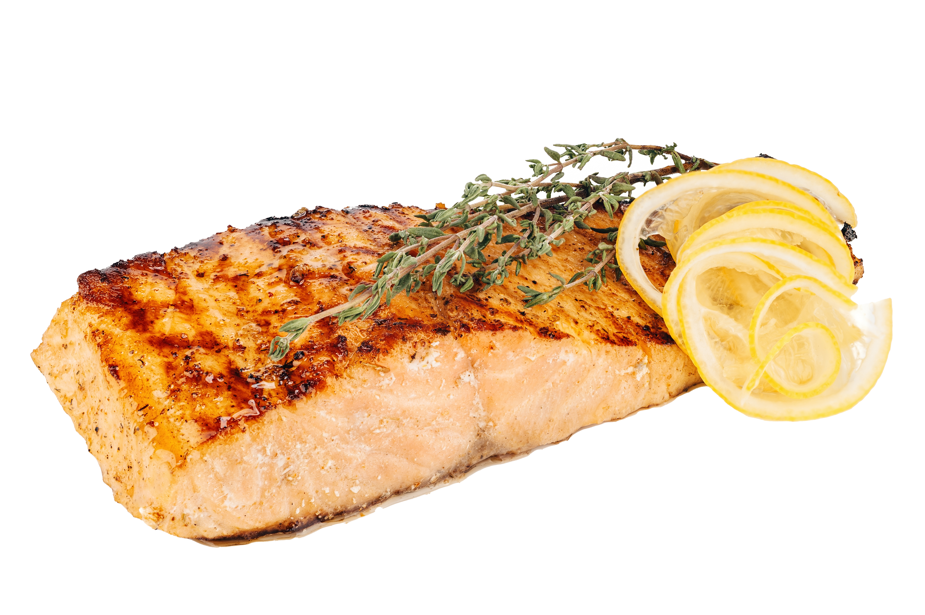
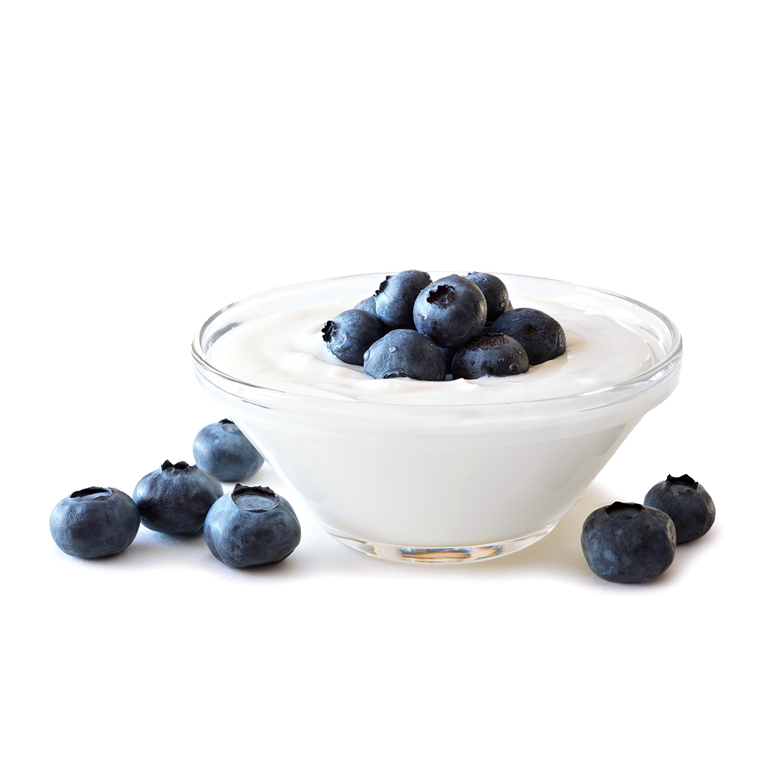
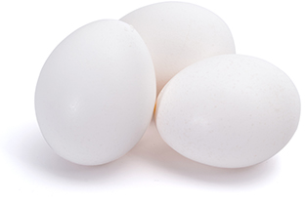
Nutrient Dense Foods - Animals
Choose a variety of lean animal foods
Meats/Poultry/Seafood
Chicken without skin
Loin/round cuts of pork/beef
Ground meats at least 90% lean
Fish & shellfish
Eggs
Low sodium deli meats
Less than 3g fat per ounce
Dairy
Yogurt
Greek yogurt
Cheese
Milk
Cottage cheese

Slide 8
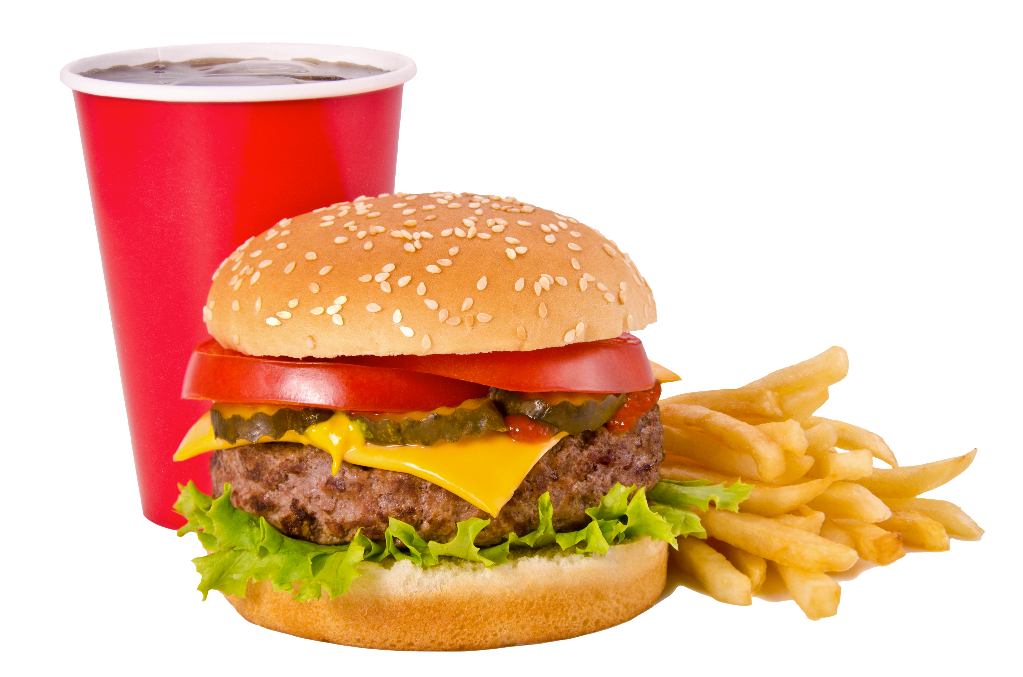
Foods to Eat in Moderation
All Foods Fit!
High fat options
Fried foods
High fat meats
High fat dairy
Butter
Sugary beverages
Sodas
Sweet tea
Juices & juice drinks
Refined grains & sweets
Cookies
Cakes
Pastries
Candy
Large amounts of crackers, chips, breads, rice, pasta
Sweetened breakfast cereals
High sodium processed foods

Slide 9
Meal
Planning
Plan meals using My Plate categories
Plan for single recipes OR component meals
Stock your freezer
Create simple go to meals

Slide 10
Sample Menus
Breakfast: 2 eggs scrambled with spinach, peppers, onion topped with 1/3 avocado, side of 1 cup melon, coffee
Lunch: Turkey sandwich on whole grain bread with 1 slice cheese, lettuce, tomato and cucumber, medium apple, water
Dinner: Salmon, small baked potato, 2 cups roasted vegetables, unsweetened iced tea
Snack: 2 ½ cups air popped popcorn
Breakfast: 1 cup Greek yogurt (plain), ¾ cup blueberries, 12 almonds, coffee
Lunch: 1 whole grain, high fiber wrap (can use corn or rice if gluten-free), 4 oz. grilled chicken breast, onions, peppers, spinach, 1/3 avocado, side of 1 cup berries, water
Dinner: 4 oz. grilled steak, 1 medium baked sweet potato topped with cinnamon, 1 cup sautéed spinach with garlic and 1 teaspoon olive oil, side salad with 1 tablespoon dressing
Snack: 1 small apple (~4oz.) with 1 tablespoon all-natural peanut butter, almond butter, cashew butter

Slide 11
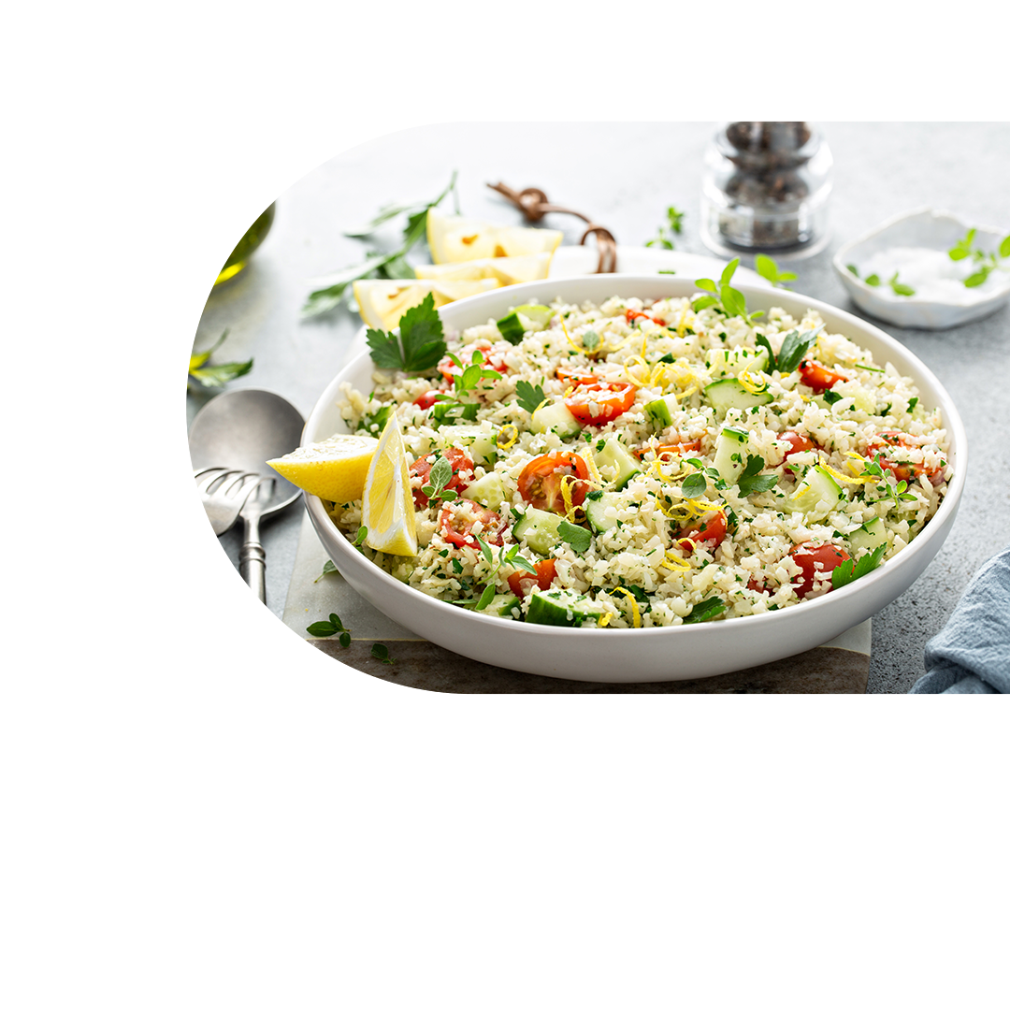
Recipe
Resources
EatingWell: Healthy Recipes, Healthy Eating
All Recipes (diabetesfoodhub.org)
Cooking Matters
Recipe Finder – Skinnytaste
Home - The Real Food Dietitians

Slide 12
Grocery Shopping
Keep house stocked with nutritious, easy to prepare foods:
Vegetables
Frozen without sauce
Frozen pre-chopped
Canned low-sodium
Tomato pasta sauce
Diced tomatoes
Beans/legumes
Canned low sodium beans
Dry beans
Peanut/nut butter
Nuts
Seeds
Grains
Brown or wild rice
Dry
90 second microwavable
Frozen
Whole wheat or bean/lentil pasta
Rolled or quick oats
Quinoa
Whole wheat bread, tortillas or English muffins
Whole wheat or corn tortillas
Whole wheat orzo or couscous

Slide 13
Grocery Shopping
Keep house stocked with nutritious,
easy to prepare foods:
Lean proteins
Eggs
Fresh or Frozen
Chicken breasts
Turkey breast
Pork tenderloin
Ground beef >= 90% lean

Slide 14
Grocery Shopping
Keep house stocked with nutritious,
easy to prepare foods:
Frozen
Fish filets
Shrimp
Edamame
Canned in water
Shredded chicken
Tuna
Salmon

Slide 15
Flavor Food Without Salt
Pairings:
Poultry: bay leaf, Italian seasoning, garlic powder, ginger, grill seasoning, poultry seasoning, onion powder, sage, thyme
Fish: basil, dill, dijon mustard, garlic powder, ginger, oregano, thyme
Beef: bay leaf, chili powder, cumin, garlic powder, ginger, grill seasoning, onion powder, oregano, parsley, thyme
Tex-Mex or southwestern dishes: chili powder, cumin, garlic powder, lime juice, onion powder, oregano
Italian dishes: basil, bay leaf, garlic powder, Italian seasoning, onion powder, oregano
Asian dishes: garlic powder, ginger, low sodium soy sauce
Soups: bay leaf, Italian seasoning, thyme

Slide 16
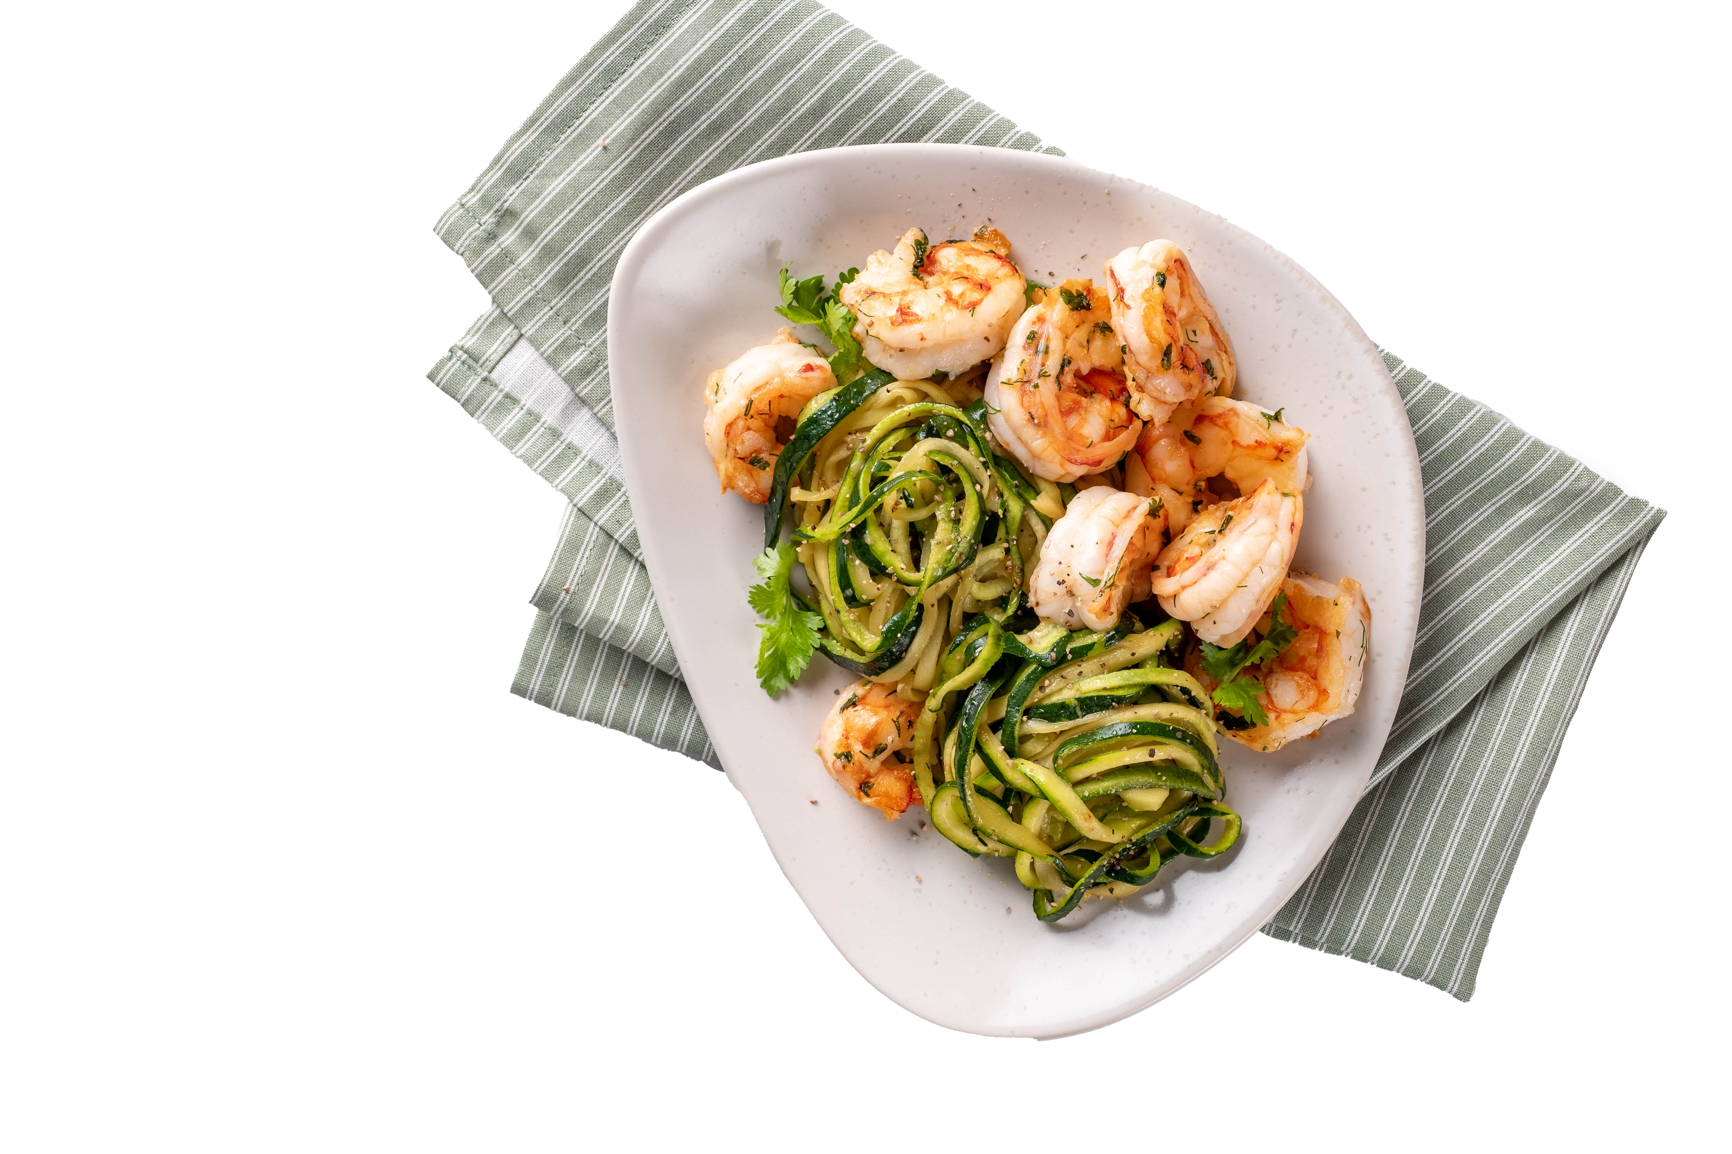
Sample Quick
Cooking Meals
High fiber pasta or zoodles with frozen shrimp, pre-cut vegetables, onion and garlic sautéed in olive oil
Veggie and cheese omelet with tossed salad
Tuna salad wrap (made with Greek yogurt) with baby carrots and dip
Black beans, rice, shredded cheese, salsa and guacamole
Peanut butter & banana sandwich with baked chips
Spinach salad with grilled chicken, mandarin oranges and slivered almonds

Slide 17
Eating Out
Look up the restaurant’s nutrition ahead of time and decide what to order before arrival
Don’t scan the menu while waiting to order in the restaurant! You will talk yourself out of a pre-selected choice
Choose zero calorie beverages
Seek out fruits and vegetables in sides and a la carte additions

Slide 18
Review Healthy
Eating Tools
Use My Plate as a guide
Choose nutrient rich foods and enjoy all foods in moderation
Find the meal planning style that works best for your house
Create a list of always available meals
Keep a supply of easy to prepare ingredients
Plan when eating out

Slide 19
How Do You Execute
These New Ideas?
Keep it simple
Pick one or two changes to make
Make a daily/weekly plan
Give up the all or nothing mentality
Stack your habits
Practice self compassion and positive thinking
Reward yourself regularly

Slide 20
Support Systems
Handle difficult situations — When obstacles inevitably arise, we sometimes need a little help keeping our goals in perspective.
The people in your support network will be there when you need to talk after a long day or when you’re feeling overwhelmed with work, family or other obligations.
Supportive friends, family, clergy and colleagues will celebrate your successes and help you learn from your failures. They can provide the encouragement you need to meet each challenge with determination and a positive attitude.

Slide 21
Support Systems
Find needed resources — Your Kelsey-Seybold dietitian and other health providers can be invaluable resources to you throughout your life. With expertise in their respective fields, they can help you figure out which steps you need to take to be successful in making healthy lifestyle changes.

Slide 22
Support Systems
Get motivated — Forming relationships with family members or peers with similar health goals will help you stay engaged in your routine and motivate you to succeed.
If you are overwhelmed or struggling, your support network should be willing to help you and offer their guidance, insight and strategies for success.
Cultivating and maintaining a social support system will benefit you throughout each of your life’s endeavors.

Slide 23
THANK YOU
KELSEY-SEYBOLD REGISTERED DIETITIANS

