Slide 1




Kelsey-Seybold Healthy Living
Workshop Class 2:
How Exercise Helps
Improve Quality of Life and Longevity
KELSEY-SEYBOLD REGISTERED DIETITIANS
Notes:
This workshop is broken down into 3 separate classes to address ways you can create positive lifestyle changes to prevent type 2 diabetes.
The topics include how foods affect our body, what foods to include to fuel your body, ways to add more activity and incorporate exercise into your life and how to make daily meal planning and prepping easier.

Slide 2

Objectives
Review My Plate
Stacking habits with SMART goals
Discuss how exercise helps reduce health risk factors
Define and provide examples of all types of exercises for all fitness levels
Notes:
Image from American Diabetes Association
https://www.diabetes.org/fitness/weight-loss

Slide 3

Stay the Course!
Be flexible, make changes along the way
Make it fun!
Remember the many benefits of healthy living both in the short- and long-term
Notes:
As we continue talking about Healthy Living it’s important to consider maintenance.
Sustaining a healthy lifestyle over time will require you to be flexible. Schedules, finances, weather, stress will vary throughout life. Keep your eyes on your goal of good health and make adjustments as needed
You might need to switch a gym membership to at home workouts. Have a plan so you don’t get behind in exercising for example
Make it fun for yourself! Challenge yourself to try a new recipe each month with your loved ones or a new way of exercising like a group class if you normally exercise alone
Lastly, remember healthy living will help you to prevent chronic diseases and conditions so you have a long and happy life

Slide 4

What is insulin resistance?
Notes:
One condition that can be improved by improving our habits is insulin resistance
What is insulin resistance?
Insulin resistance is when cells in your muscles, fat, and liver don’t respond well to insulin and can’t easily take up glucose from your blood.
Prediabetes is also known as insulin resistance. When you eat carbohydrate foods, your body actually makes excess insulin because the cell’s in your body are not responding. Insulin is a storage hormone and the excess stores carbohydrate (sugar) as fat. This can leave you feeling fatigued and actually more hungry making you want to eat again and repeating the cycle. Researchers don’t fully understand what causes insulin resistance and prediabetes, but they think excess weight and lack of physical activity are major factors. (Source: CDC)

Slide 5
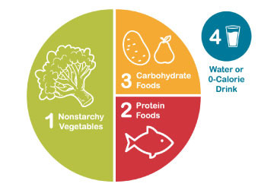


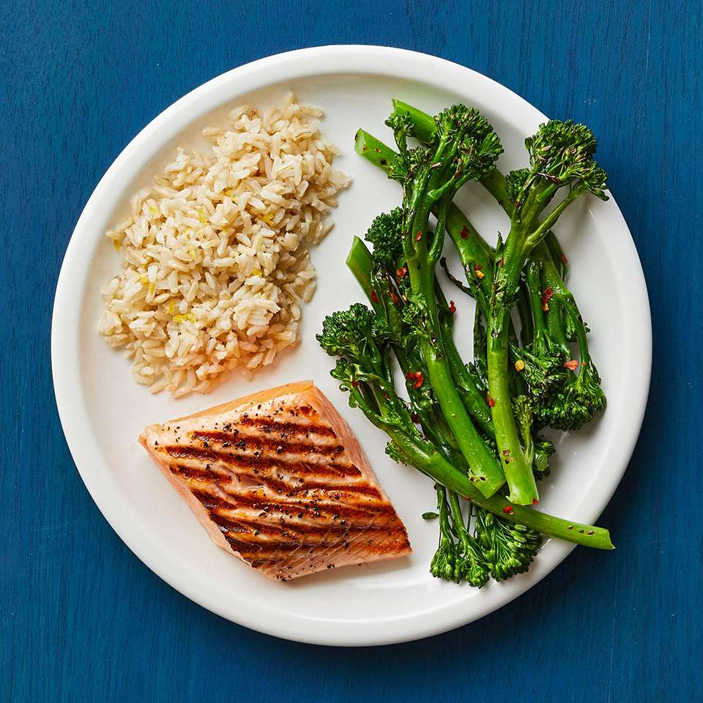
Meal Planning with The Plate Method
Fill half of your plate with non-starchy vegetables
Fill ¼ plate with 1 cup of starch/grain/fruit
Fill ¼ plate with 3-4 ounces of protein
Drink water or another beverage without sugar
Pictures by American Diabetes Association
Notes:
Here are 4 components that make up our diet. Filling half your plate with vegetables will help you portion control and balance your plate. Drinking more water than any other beverage is also important for our health.

Slide 6
SMART Goal Examples
• To help me add more physical activity to my weekly routine, I will walk around the parking garage at work during my lunch period at least three days per week starting tomorrow.
• To meet my goal of better nutrition, I will eat 1 cup raw vegetables at lunch and ½ cup cooked vegetables at dinner every day starting tonight.
• Beginning Monday, I will go to sleep by 10PM, so I can get at least eight hours of sleep each weeknight.
• Over the next two weeks, my goal is to find at least five minutes every day to meditate to help me better manage my stress
SMART Goals
Assess plate/activity goal
Add new goal
Specific
Measurable
Action Oriented
Realistic
Timed
Notes:
In class 1 we discussed creating specific goals to work on each day. It is important to evaluate what is working that you can continue and then add a new goal. If something did not go as planned, just reassess what you can do differently and try again. Sometimes we need to try a few ideas to find the plan that works best with our different schedules.

Slide 7




Activity Vs. Exercise
Exercise: Planned, intentional, consistent and over a period of time
Goal of walking 30 minutes, 5 days a week for the next 3 months
Goal of doing 30 minutes of yoga, 3 times a week for the
next 3 months
Activity: Moving more
throughout the day
Activity: Moving more
throughout the day
Activity: Moving more
throughout the day
Activity: Moving more
throughout the day
Notes:
Getting daily activity throughout the day is important for our overall health. But adding purposeful exercise into our week will make a bigger impact on reducing the insulin resistance.

Slide 8

How Does Exercise Help Prevent Type 2 Diabetes?
Blood sugar control
Improves insulin sensitivity
Increased muscle mass
Promotes weight loss
Notes:
Our muscles contain energy burning power plants and when the muscle is strong and being used regularly, it burns more fuel which is sugar (carbohydrate). Our bodies will be able to function with lower insulin production and excess weight will be reduced. We burn more energy when we are moving more intensely and continue to burn for awhile after.

Slide 9

Before You Exercise
Check with your doctor to find out what kind of exercise is optimal for you or if you have any limitations.
Remember to perform exercise that is within your body’s own limitations and to start small.
Notes:
Image from American Diabetes Association
https://www.diabetes.org/fitness

Slide 10
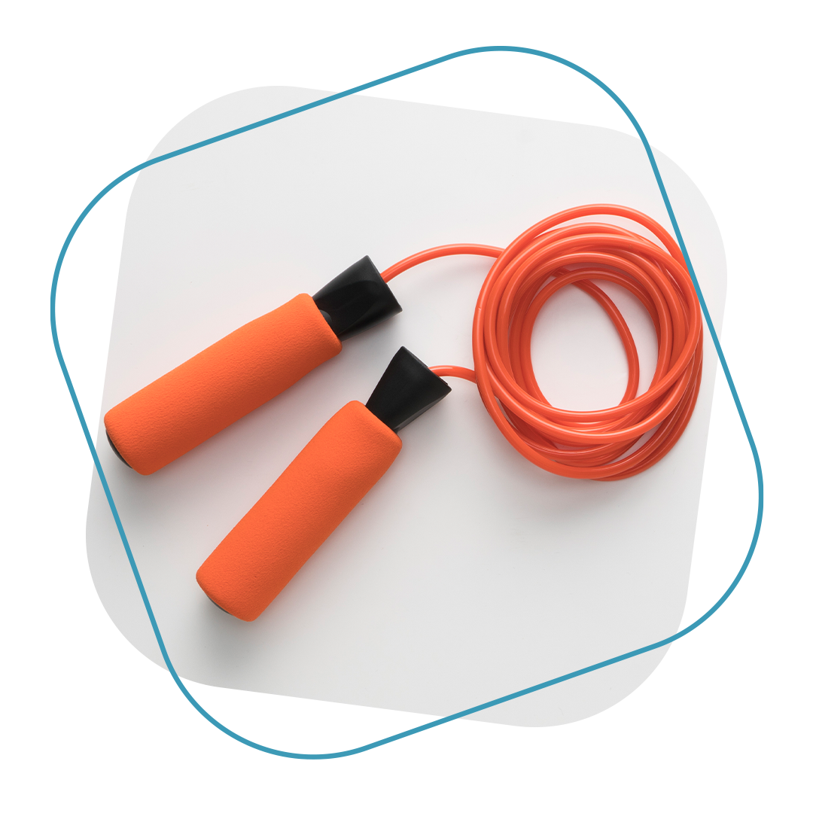
Equipment
Positive attitude
Supportive shoes
Well fitted socks
Water bottle
Optional equipment:
Resistance bands
Jump rope
Weights
Mat
Notes:
The most important thing we need to create change is a positive attitude. Positive thoughts around moving our body makes us feel good about it and this encourages our action of consistent exercise. If you have limitations due to injury, balance or you are just starting out, focus on what you can do and not what you can’t do.

Slide 11

Cardiovascular Exercise
These are activities that raise your heart rate.
Examples are brisk walking, jogging, biking or dancing.
Aim for 150 minutes a week of cardio exercise. Can be done 10 minutes at a time.
Notes:
Image from American Diabetes Association
https://www.diabetes.org/fitness/weight-loss

Slide 12
Chair Exercises
Cardio
Start by choosing an aerobic activity that you can do almost daily, such as taking 5-minute walks throughout the day or parking farther away so you will take more steps. You don't even have to break a sweat or change clothes.
Notes:
Most exercise you can do standing can also be done sitting in a stable chair. Think of marching in place, stepping side to side or tapping your toe one at a time in front of you. Just moving your arms and legs even when seated will increase your heart rate.

Slide 13
Chair Exercises
Cardio
Notes:
Other activities like punching forward, side to side and over head can add more intensity.

Slide 14

Resistance Exercise
This involves using your own body weight, weights, or resistance bands to build muscle and strength.
This helps your body burn more calories at rest. Goal is at least 2 times a week.
Notes:
We lose muscle strength as we age which can also affect our balance and independence. The good news is that no matter where you are currently, you can always improve your strength and regain muscle.

Slide 15
Chair Exercises
Resistance
To build some strength and muscle, add some resistance training at least 2 days per week. It is fine
to start with wall push-ups and other easy activities that you can do during work breaks, at your
desk or at home using household items.
Notes:
We all sit throughout the day and have to get out of our chairs. This is the perfect opportunity to strengthen not just our leg muscles but also our core muscles as they support us changing position. Practice standing up and sitting down without using your hands. If this is too difficult, just focus on using your arms a little less each day and pay attention to what your leg muscles are doing. To strengthen your arms, press your hands into the side of the chair and push up. Both of these exercises done regularly will improve the strength of these muscles.

Slide 16
Chair Exercises
Resistance
Notes:
Push ups are excellent to work your entire upper body but they are challenging. Start with wall push ups or use a kitchen or bathroom counter. To work the back of your legs, you can do standing leg curls and calf raises using the back of a chair or counter for support.

Slide 17
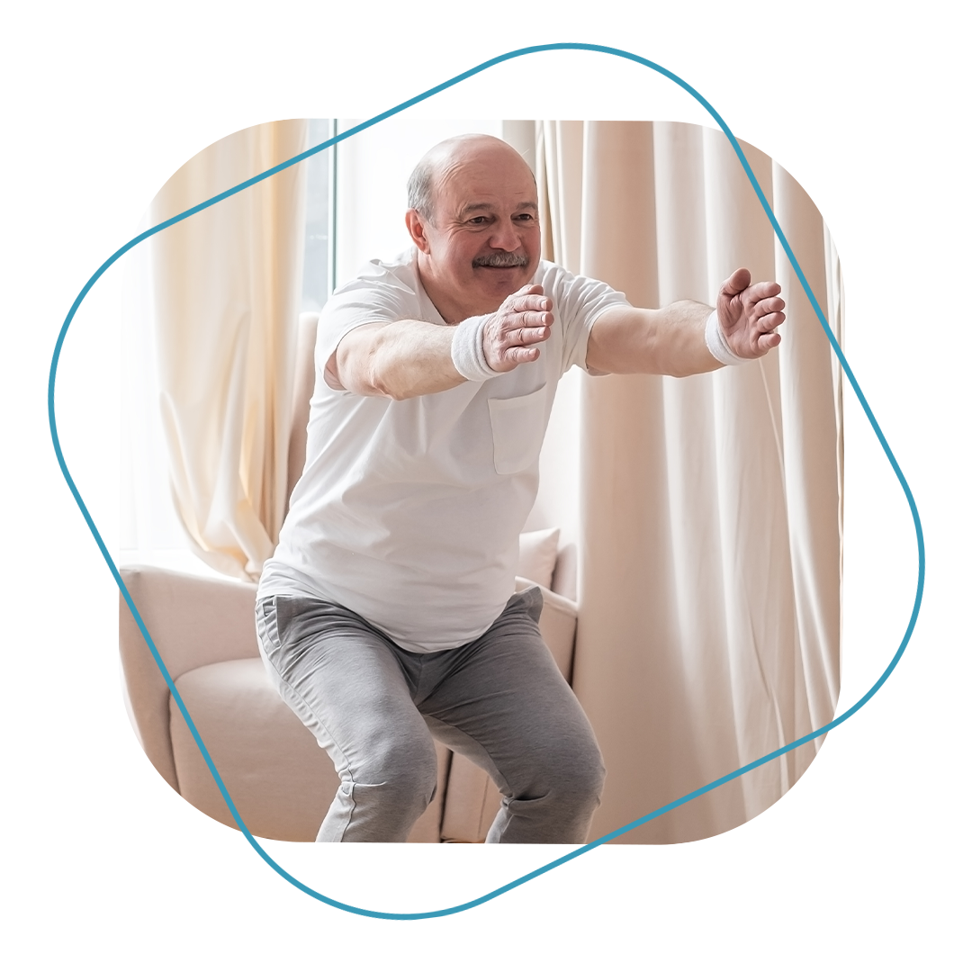
Balance Exercise
Helps with daily activities such as walking and going up and down the stairs.
Balance exercises can also help prevent falls.
Yoga and Tai Chi are examples of balance exercises.
Notes:
Balance is also something we lose as we age if we don’t work on it. There are classes that include balance along with strength and stretching or you can practice balancing while doing other tasks.

Slide 18
Chair Exercises
Balance
Start your balance training by holding on to something stable and trying to stand on one leg at
a time several times per day.
Add in some other exercises along the way to help you get more
balance and avoid falls.
Notes:
These exercises could be done while you brush your teeth. Use your bathroom counter for support. You could also practice them anytime you need to stand and wait for something, like preheating the oven.

Slide 19
Chair Exercises
Balance

Slide 20

Stretching/Flexibility
Gives you more freedom of movement for other exercise as well as your daily activities.
Stretch after exercise, not before. Hold for 10-30 seconds- without pain.
Notes:
Some of us are born more flexible than others. Like other things, we lose it if we don’t use it. Being flexible protects us as we move throughout the day. Gentle stretching throughout the day helps break up prolonged sitting or standing and after exercise, it helps improve flexibility when your muscles are already warm.

Slide 21
Chair Exercises
Flexibility
Stretch 2 to 3 days per week as well. Break up periods of sitting with easy stretches. This is a great
way to work stretching into your day, and you will feel better.
Notes:
Do these throughout the day especially if you are on the computer or driving for long periods of time.

Slide 22
Chair Exercises
Flexibility

Slide 23
Chair Exercises
Flexibility

Slide 24

Goals for Activity and Exercise
Exercise goals:
Cardio/aerobics: 150 minutes/week or 30 minutes 5 days/week
Strength training 2-3 days/week working major muscle groups
Stretching or balance exercises daily, or 3x/week
Move for a few minutes every hour to avoid prolonged sitting
Aim for 10,000 steps/day
Notes:
If 10,000 steps is too difficult, start with doing a little more than your average day. Build up over time.
Break up sitting with walking and stretching or strength exercises throughout the day.
Make an exercise plan that you can stick to.

Slide 25


Resources for
Activity and Exercise
YouTube is a great resource!
Exercise
Apps!
Fit On (free)
Map My Walk (free)
SilverSneakers GO (free)
7-Minute Chi (free)
Sworkit (free)
C25K (free)
Daily Burn (paid)
Silver Sneakers program
Sit and Be Fit
Walking at Home with
Leslie Sansone
Yoga with Adriene

Slide 26
THANK YOU
KELSEY-SEYBOLD REGISTERED DIETITIANS
Notes:
This workshop is broken down into 3 separate classes to address ways you can create positive lifestyle changes to prevent type 2 diabetes.
The topics include how foods affect our body, what foods to include to fuel your body, ways to add more activity and incorporate exercise into your life and how to make daily meal planning and prepping easier.

